Slide 1
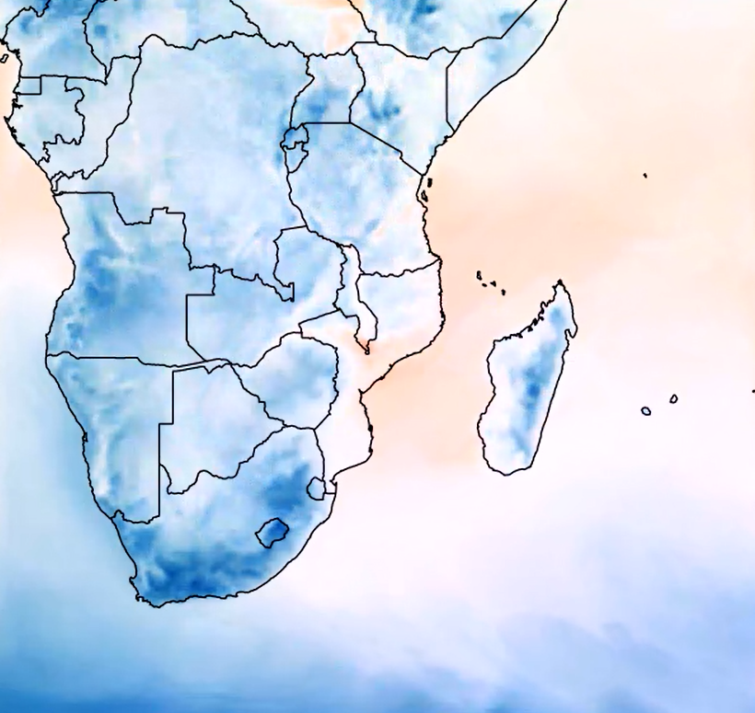
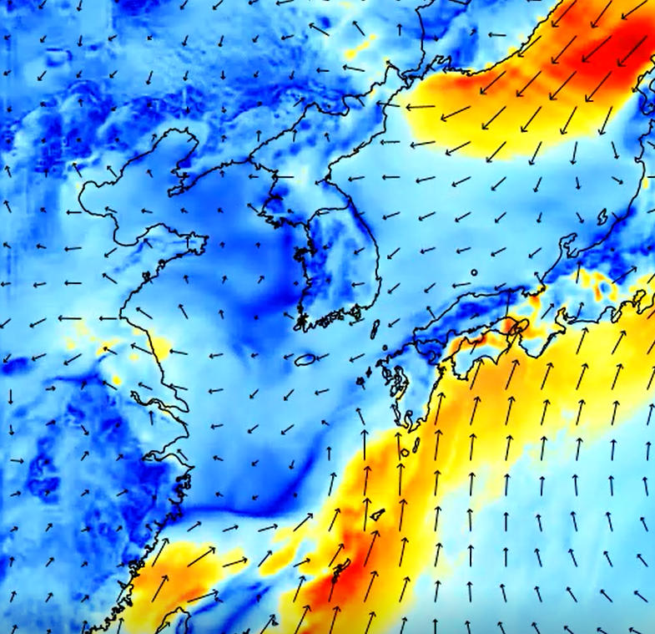
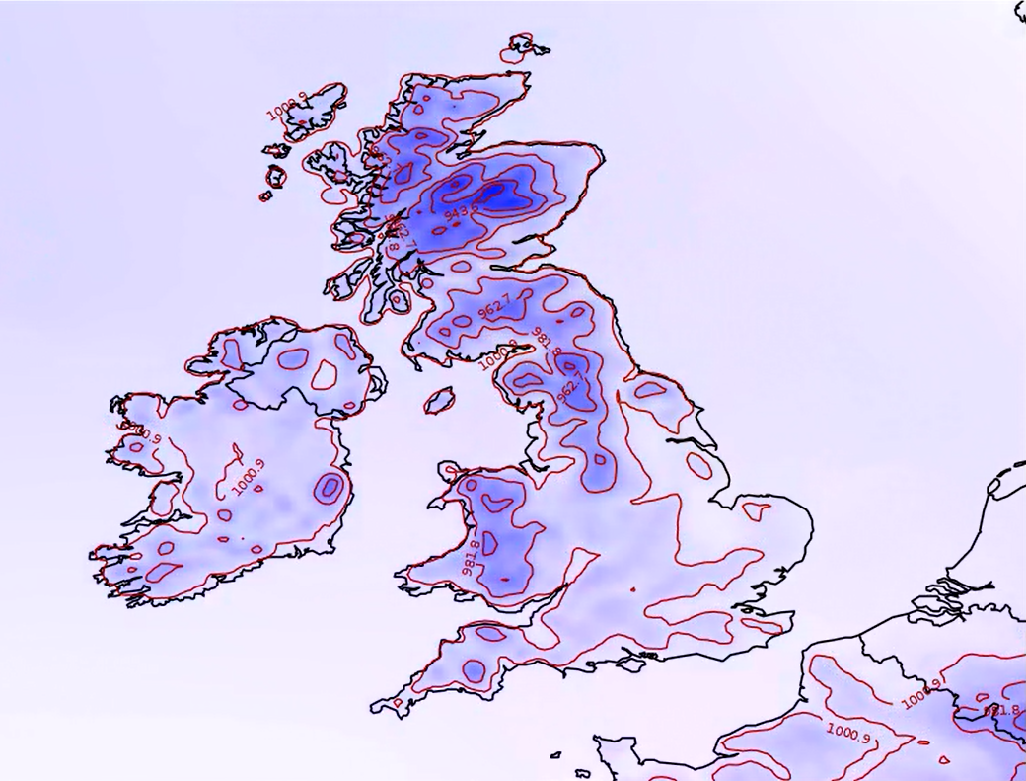
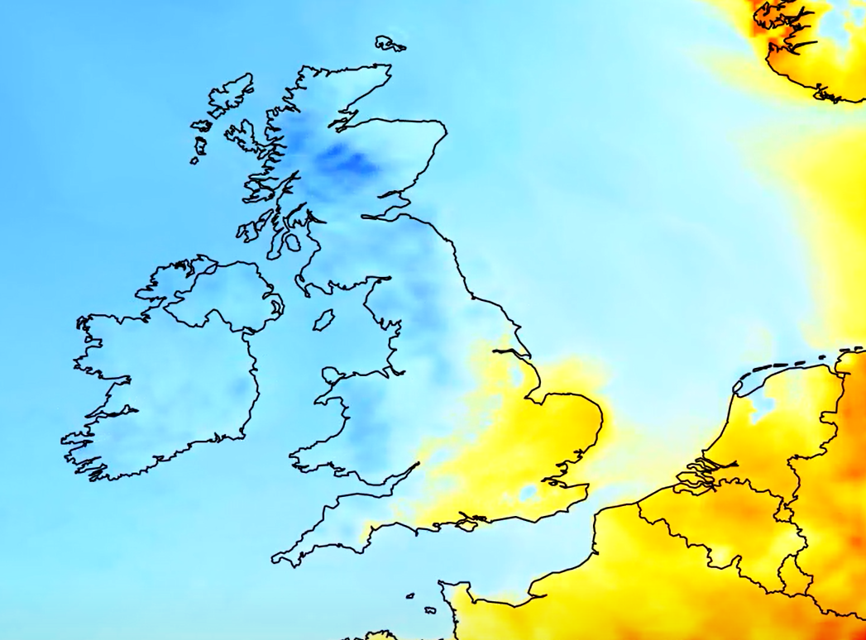
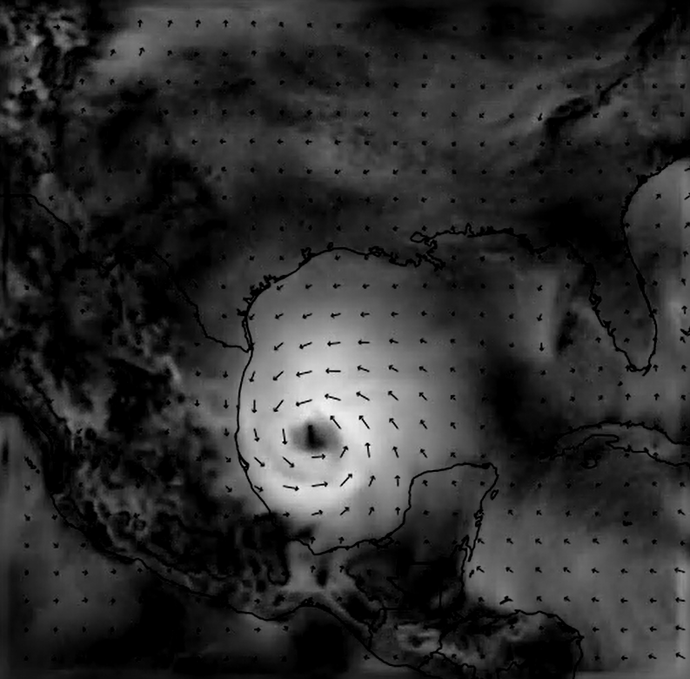
An intro to:
Numerical Weather Prediction
Hitesh Kumar
Mathematics undergraduate colloquium – 23/01/19
Intro to NWP – Front page
Slide: 1/56

Slide 2
Contents:
The fundamental process – start to end
Domain setup + interpolation
Finding IC’s and BC’s
Governing equations
Model discretisation
Some results
Cumulative precipitation – Indian monsoon
Hurricane tracking - Florence
Problems and some solutions
Accuracy of initial conditions + Data assimilation
Post processing + Quantile mapping
Using the software (VM)
Intro to NWP – Contents
Future of NWP – Contents
Slide: 2/56
Slide: 2/

Slide 3
Contents:
The fundamental process – start to end
Domain setup + interpolation
Finding IC’s and BC’s
Governing equations
Model discretisation
Some results
Cumulative precipitation – Indian monsoon
Hurricane tracking - Florence
Problems and some solutions
Accuracy of initial conditions + Data assimilation
Post processing + Quantile mapping
Using the software (VM)
Future of NWP – Contents
Intro to NWP – Domain setup and interpolation
Slide: 2/
Slide: 3/56

Slide 4
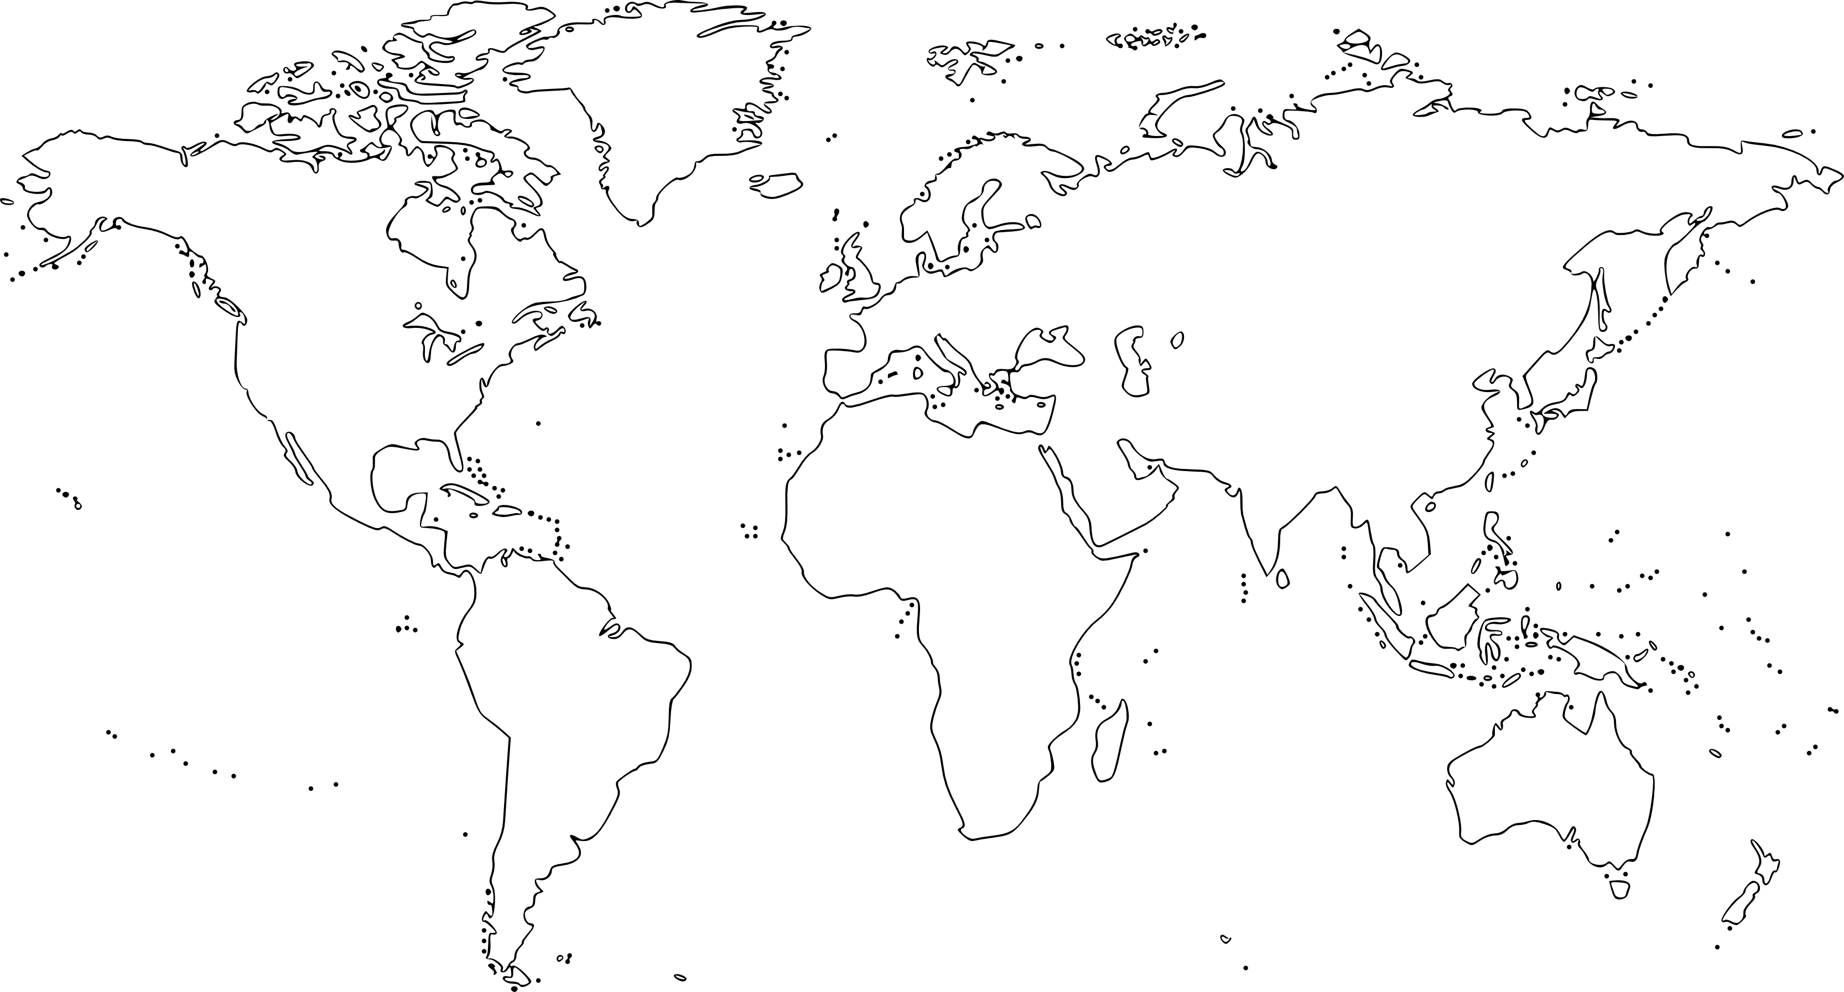
Future of NWP – The fundamental process – Finding IC’s/BC’s
Intro to NWP – Domain setup and interpolation
Slide: 2/
Slide: 4/56

Slide 5
~ 9 km – 40 km
Future of NWP – The fundamental process – Finding IC’s/BC’s
Intro to NWP – Domain setup and interpolation
Slide: 2/
Slide: 5/56

Slide 6
Future of NWP – The fundamental process – Finding IC’s/BC’s
Intro to NWP – Domain setup and interpolation
Slide: 2/
Slide: 6/56

Slide 7
~ 0.3 km – 9 km
Future of NWP – The fundamental process – Finding IC’s/BC’s
Intro to NWP – Domain setup and interpolation
Slide: 2/
Slide: 7/56

Slide 8
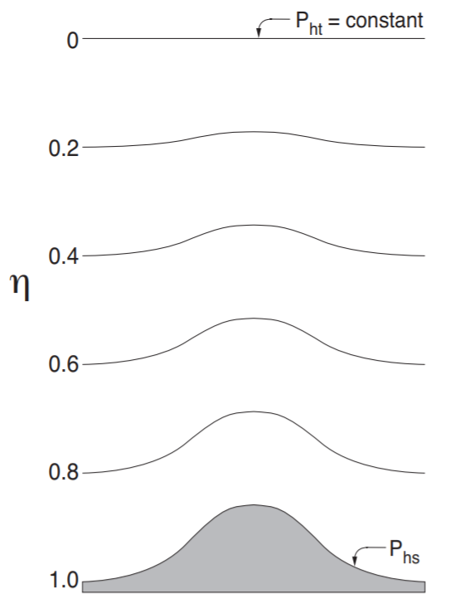
[1]
Intro to NWP – Domain setup and interpolation
Future of NWP – The fundamental process – Variables
Slide: 8/56
Slide: 2/

Slide 9
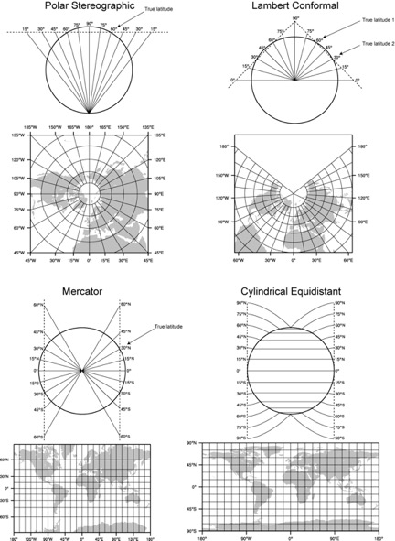
[2]
Future of NWP – The fundamental process – Finding IC’s/BC’s
Intro to NWP – Domain setup and interpolation
Slide: 2/
Slide: 9/56

Slide 10
[3]
Future of NWP – The fundamental process – Finding IC’s/BC’s
Intro to NWP – Domain setup and interpolation
Slide: 2/
Slide: 10/56

Slide 11
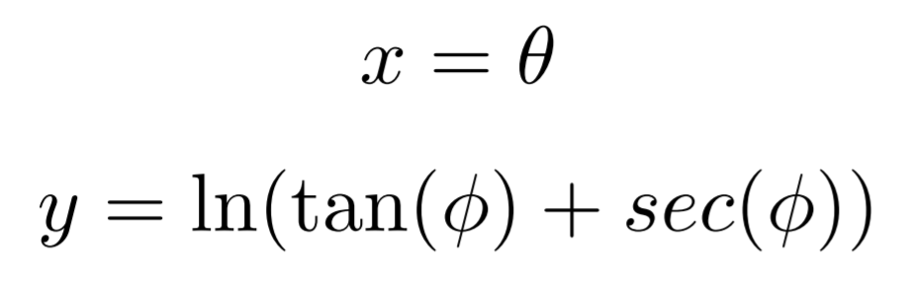
Future of NWP – The fundamental process – Finding IC’s/BC’s
Intro to NWP – Domain setup and interpolation
Slide: 2/
Slide: 11/56

Slide 12
Contents:
The fundamental process – start to end
Domain setup + interpolation
Finding IC’s and BC’s
Governing equations
Model discretisation
Some results
Cumulative precipitation – Indian monsoon
Hurricane tracking - Florence
Problems and some solutions
Accuracy of initial conditions + Data assimilation
Post processing + Quantile mapping
Using the software (VM)
Future of NWP – Contents
Intro to NWP – Finding initial and boundary conditions
Slide: 2/
Slide: 12/56

Slide 13
Future of NWP – The fundamental process – Finding IC’s/BC’s
Intro to NWP – Finding initial and boundary conditions
Slide: 2/
Slide: 13/56

Slide 14
Future of NWP – The fundamental process – Finding IC’s/BC’s
Intro to NWP – Finding initial and boundary conditions
Slide: 2/
Slide: 14/56

Slide 15
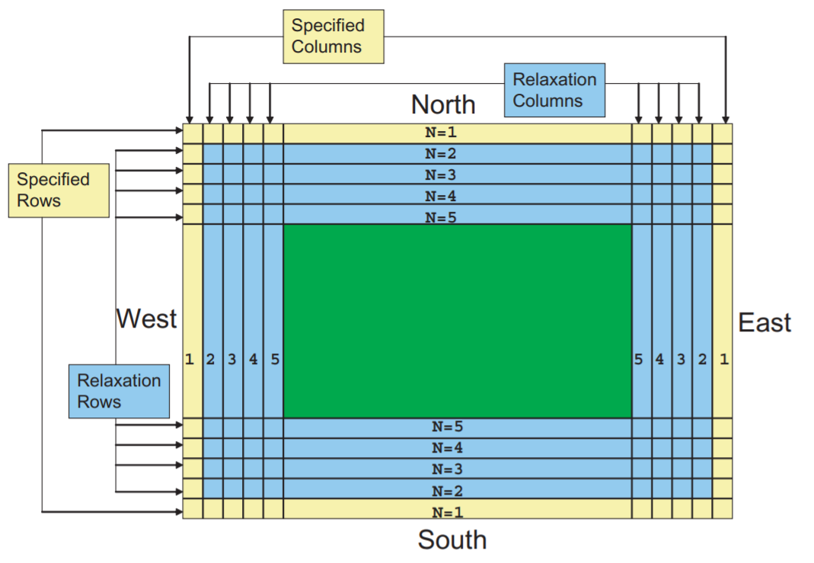
[4]
Future of NWP – The fundamental process – Finding IC’s/BC’s
Intro to NWP – Finding initial and boundary conditions
Slide: 2/
Slide: 15/56

Slide 16
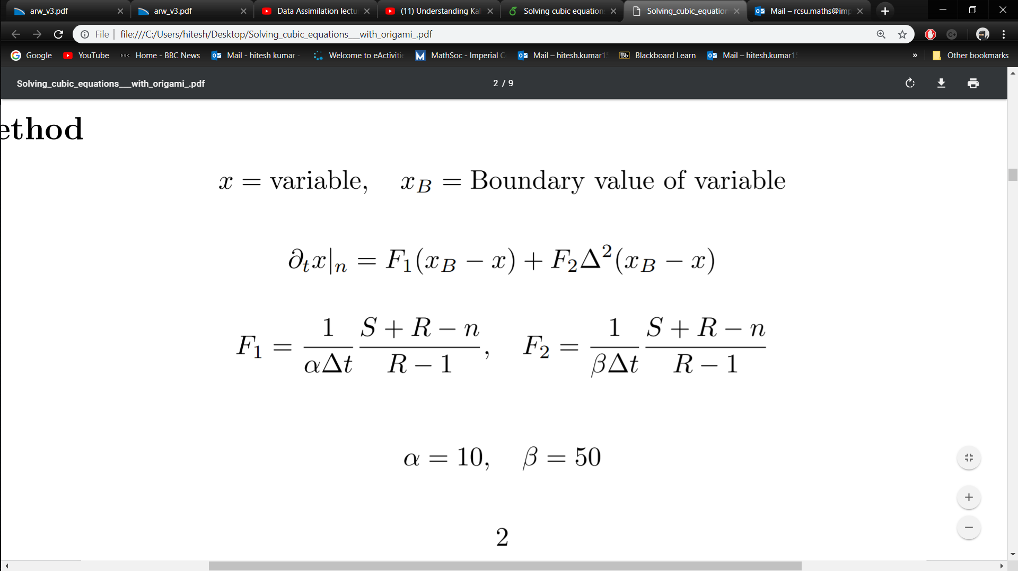
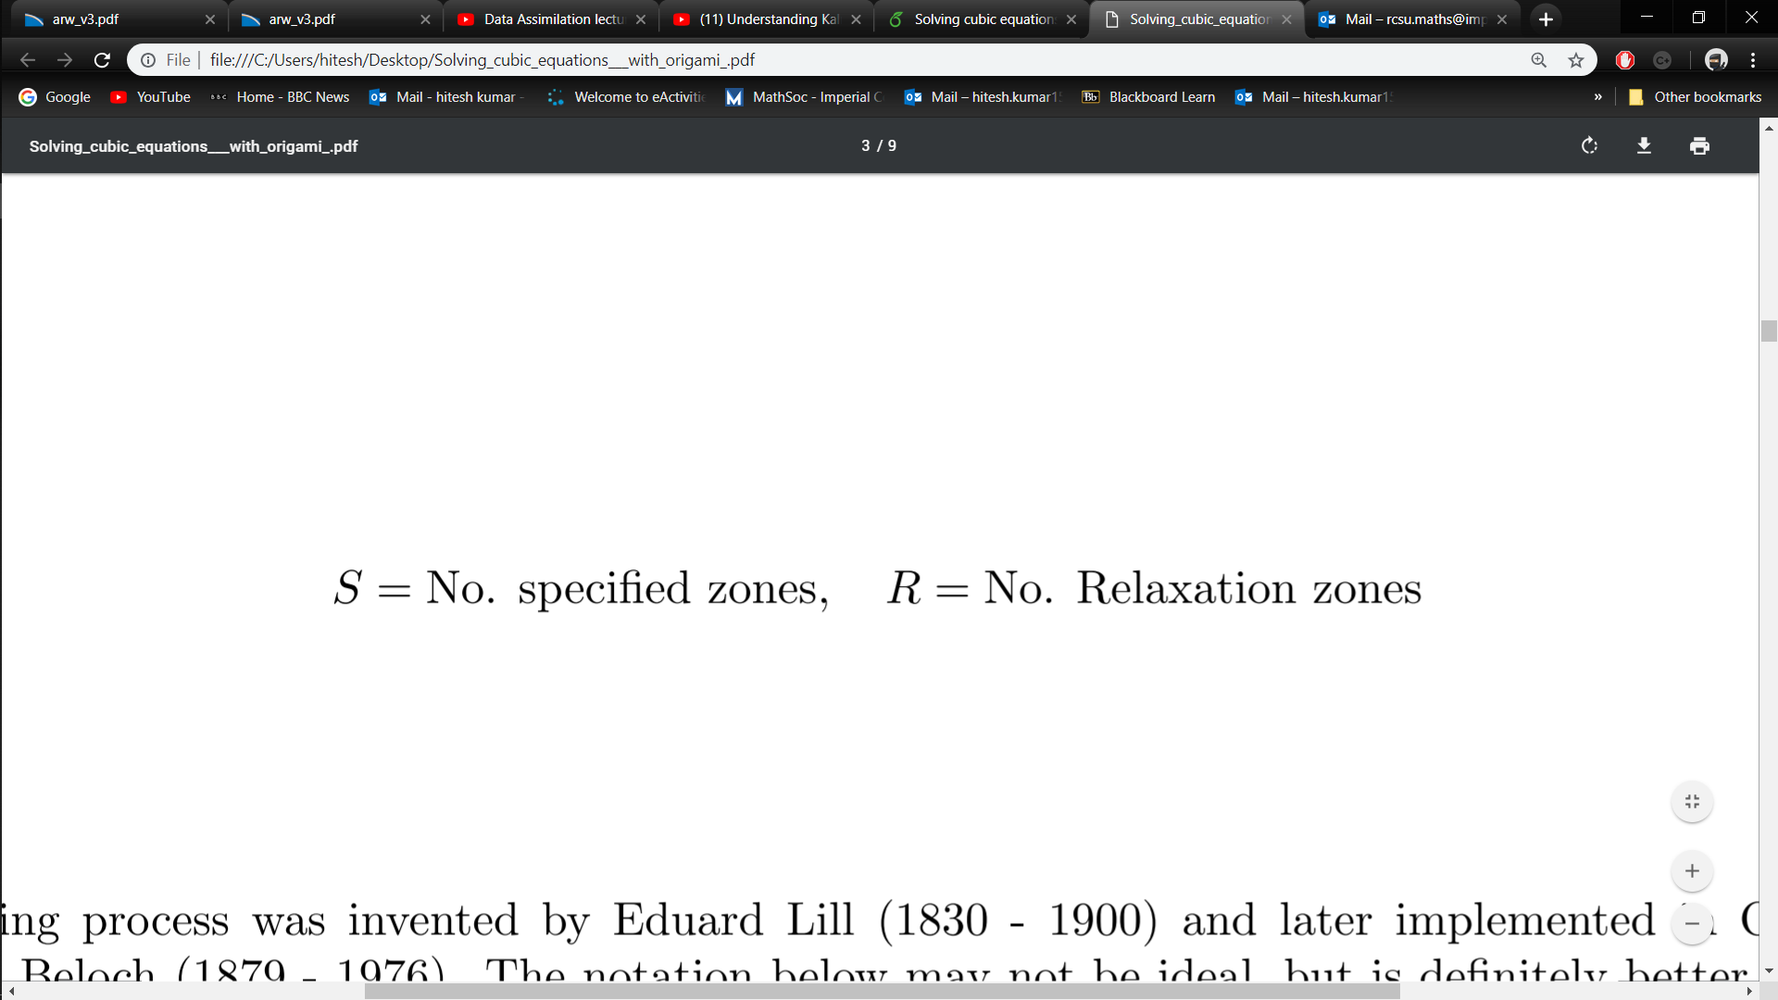
Future of NWP – The fundamental process – Finding IC’s/BC’s
Intro to NWP – Finding initial and boundary conditions
Slide: 2/
Slide: 16/56

Slide 17

NCEP GFS: http://www.ftp.ncep.noaa.gov/data/nccf/com/gfs/prod/
(Or Global Forecast from NCAR RDA: https://rda.ucar.edu/datasets/ds094.0/ if you’re desperate)
Future of NWP – The fundamental process – Finding IC’s/BC’s
Intro to NWP – Finding initial and boundary conditions
Slide: 2/
Slide: 17/56

Slide 18
Future of NWP – The fundamental process – Finding IC’s/BC’s
Intro to NWP – Finding initial and boundary conditions
Slide: 2/
Slide: 18/56

Slide 19
Future of NWP – The fundamental process – Finding IC’s/BC’s
Intro to NWP – Finding initial and boundary conditions
Slide: 2/
Slide: 19/56

Slide 20
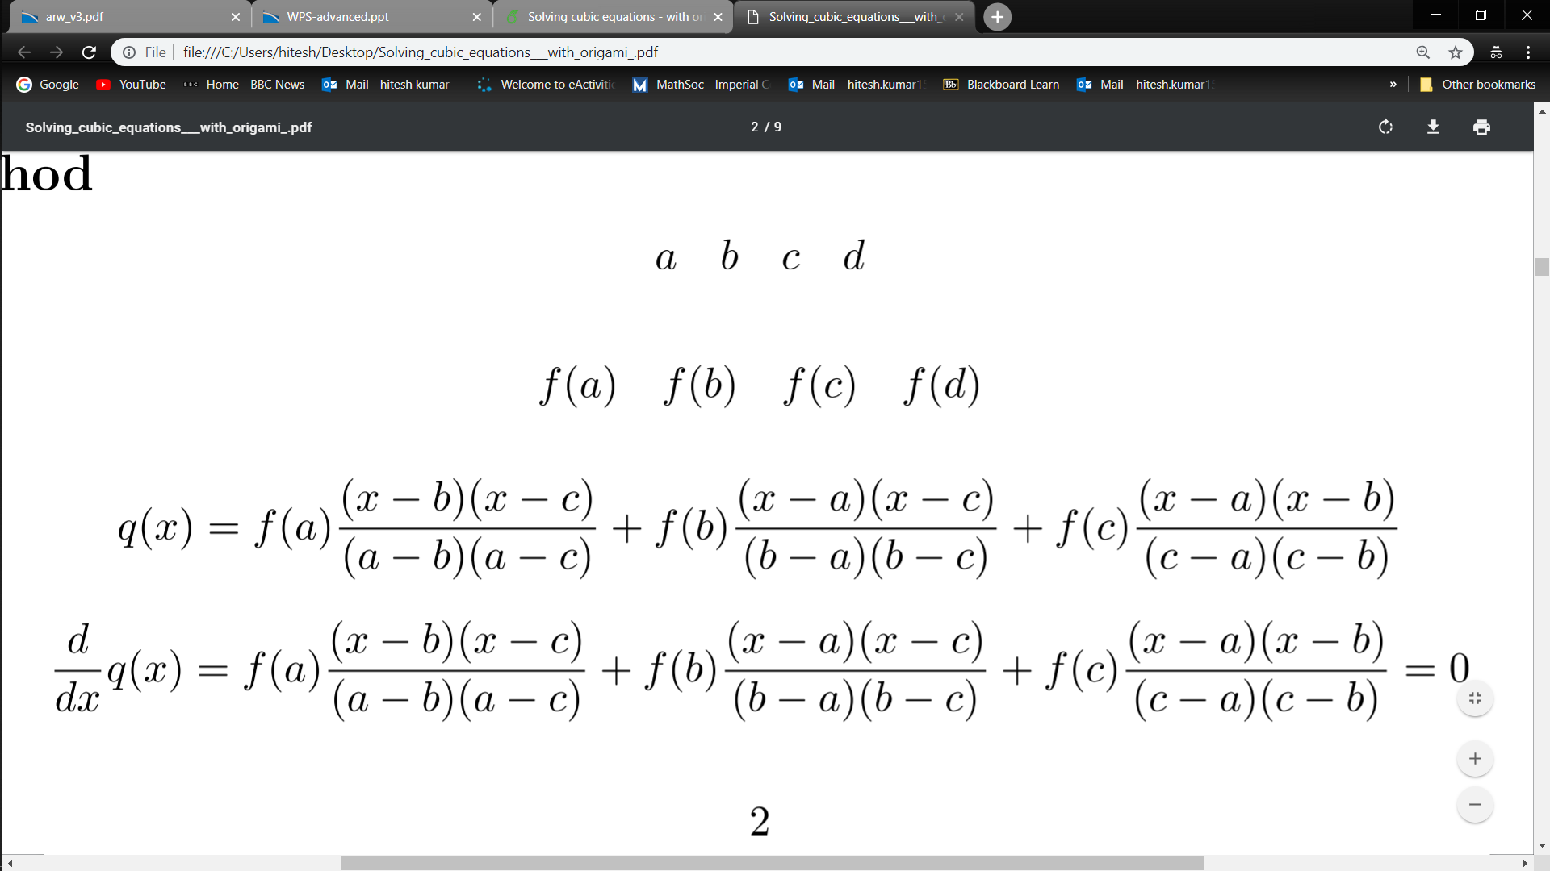


Future of NWP – The fundamental process – Finding IC’s/BC’s
Intro to NWP – Finding initial and boundary conditions
Slide: 2/
Slide: 20/56

Slide 21
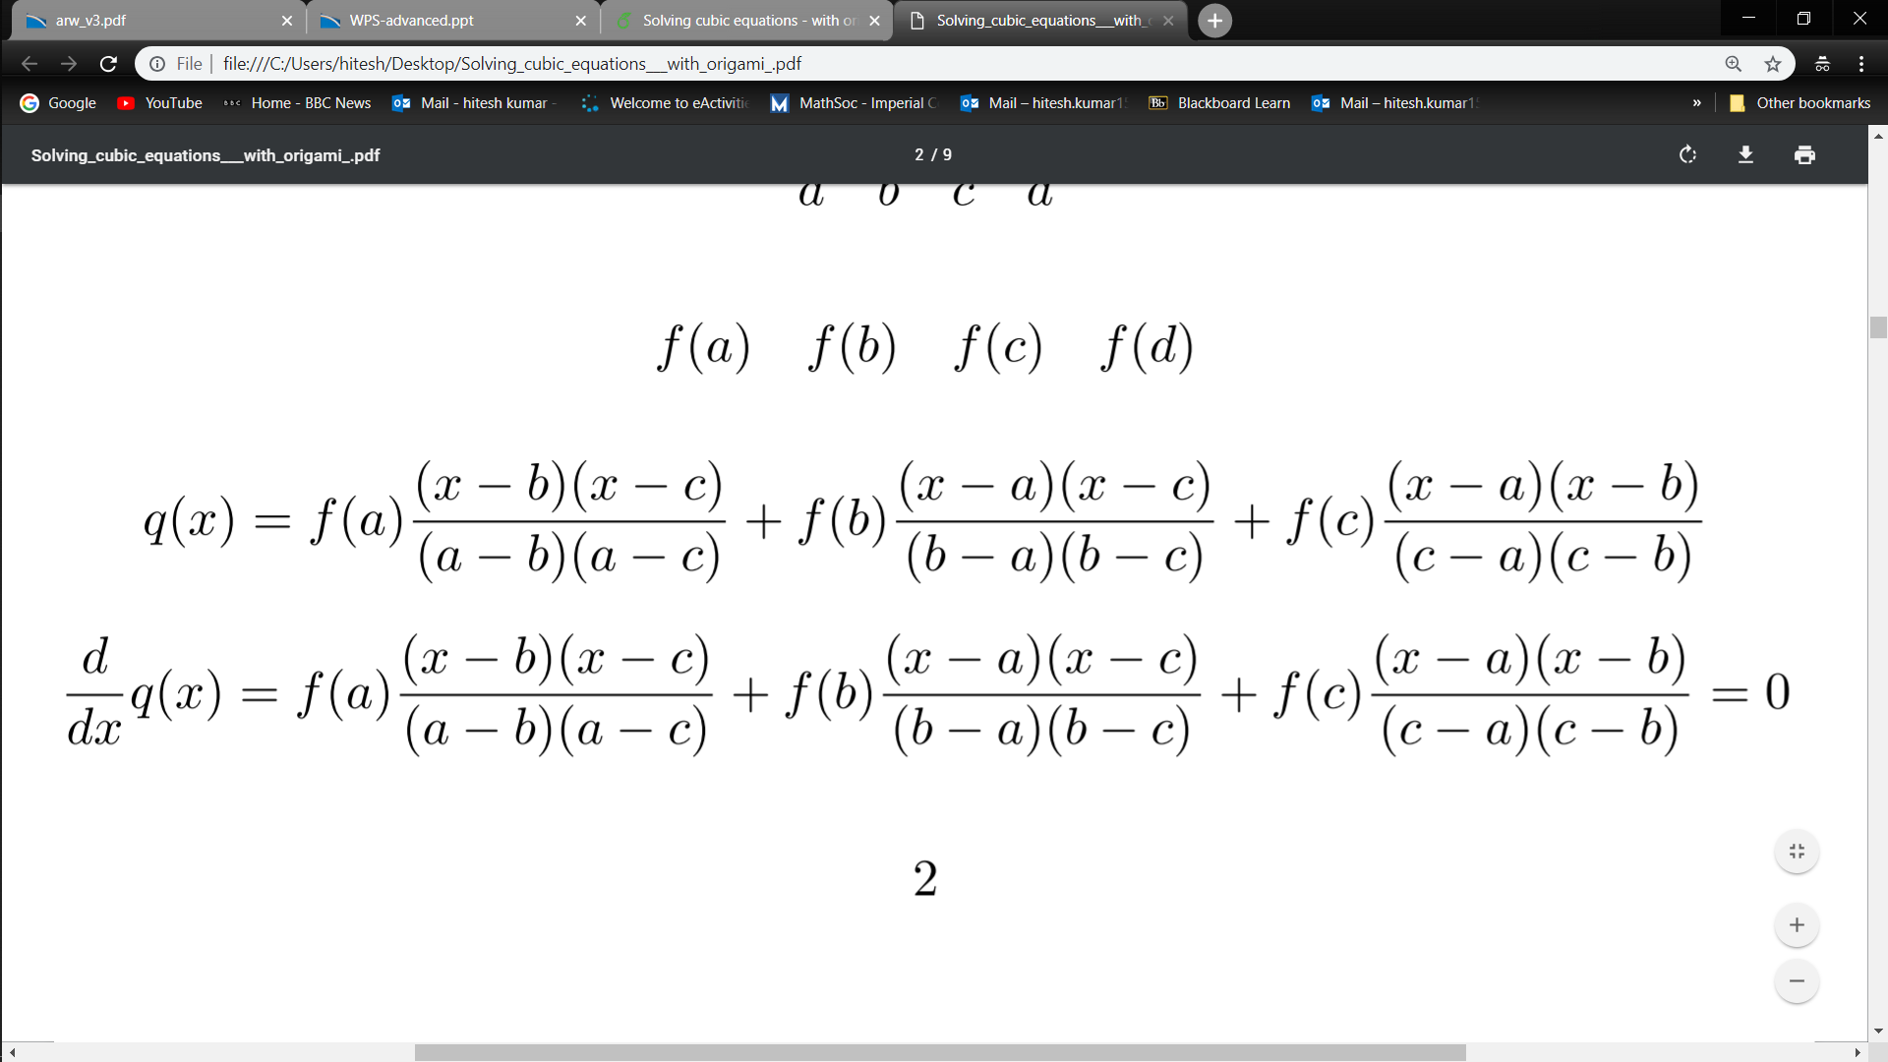
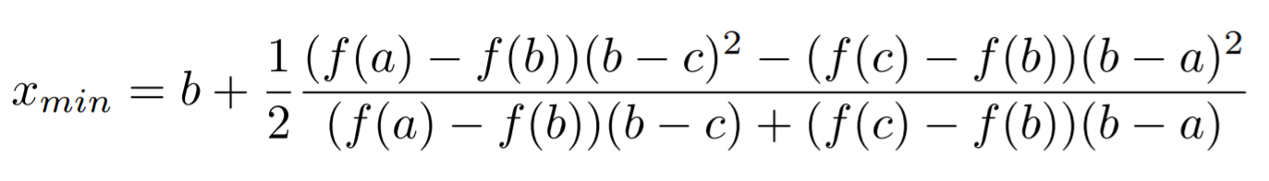
Future of NWP – The fundamental process – Finding IC’s/BC’s
Intro to NWP – Finding initial and boundary conditions
Slide: 2/
Slide: 21/56

Slide 22
Future of NWP – The fundamental process – Finding IC’s/BC’s
Intro to NWP – Finding initial and boundary conditions
Slide: 2/
Slide: 22/56

Slide 23
Contents:
The fundamental process – start to end
Domain setup + interpolation
Finding IC’s and BC’s
Governing equations
Model discretisation
Some results
Cumulative precipitation – Indian monsoon
Hurricane tracking - Florence
Problems and some solutions
Accuracy of initial conditions + Data assimilation
Post processing + Quantile mapping
Using the software (VM)
Intro to NWP – Governing equations
Future of NWP – Contents
Slide: 23/56
Slide: 2/

Slide 24
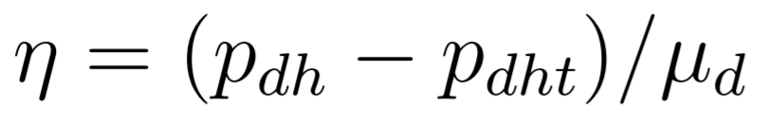
Variables of atmospheric dynamics
Vertical pressure-based coordinate
Intro to NWP – Governing equations
Future of NWP – The fundamental process – Variables
Slide: 24/56
Slide: 2/

Slide 25
[1]
Future of NWP – The fundamental process – Variables
Intro to NWP – Governing equations
Slide: 2/
Slide: 25/56

Slide 26
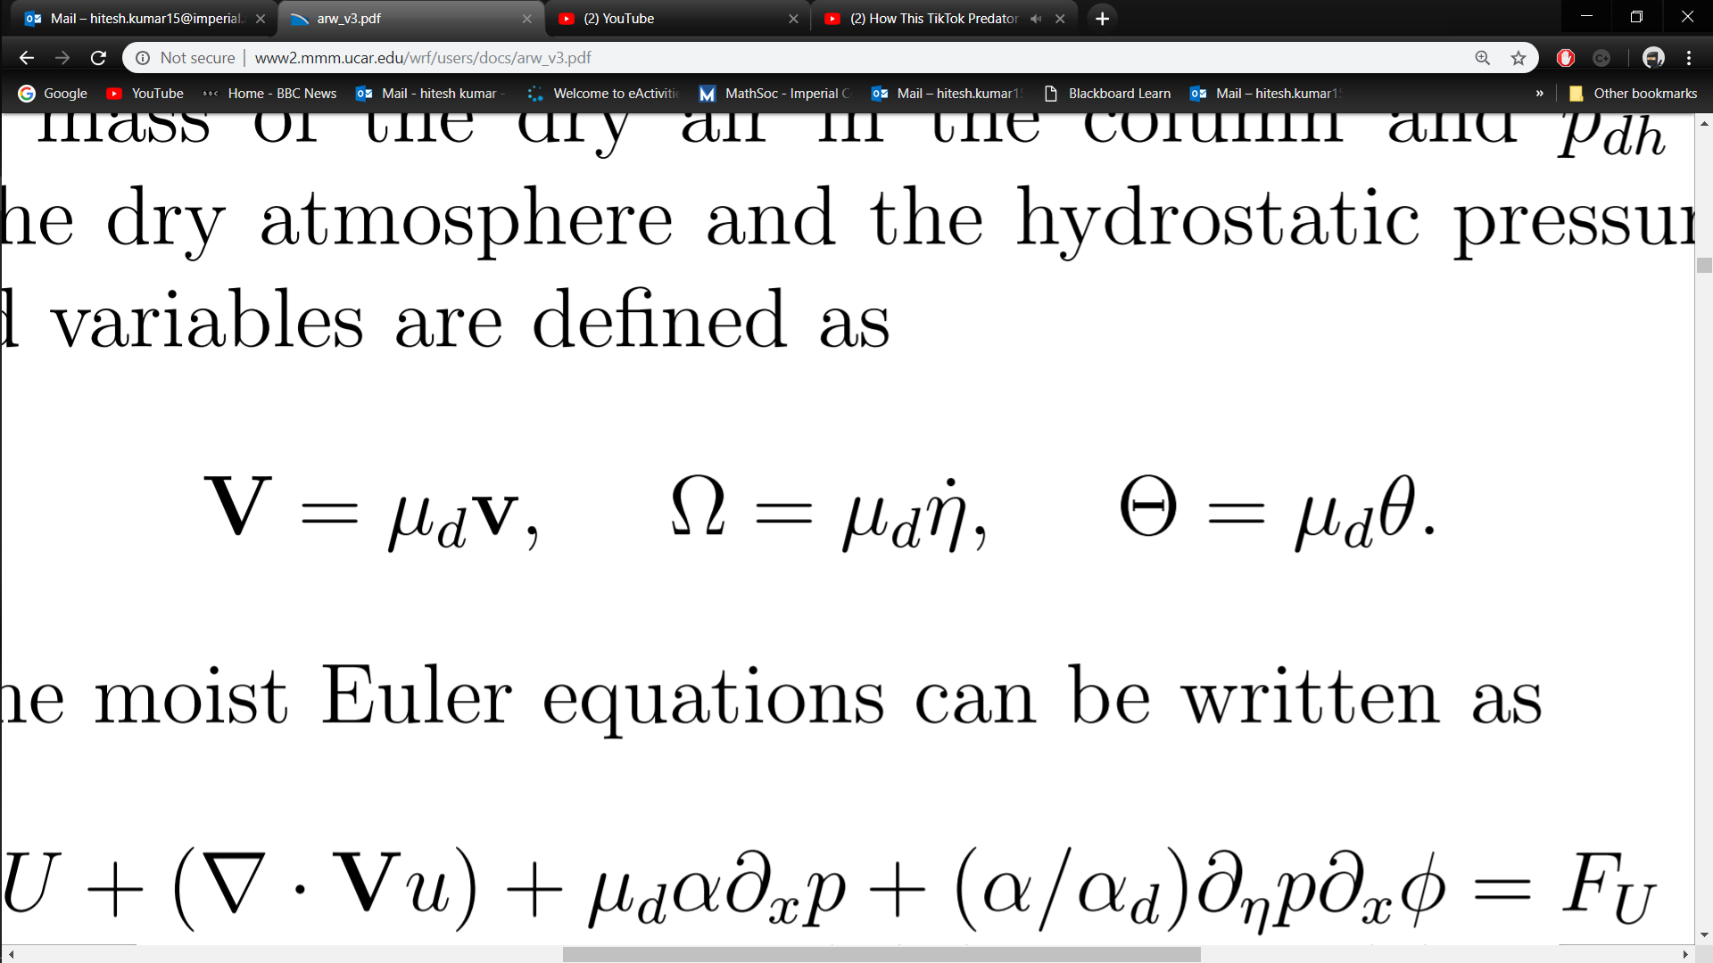
Variables of atmospheric dynamics
Vertical pressure-based coordinate
3D covariant wind velocity
3D contravariant wind velocity
Potential temperature
Intro to NWP – Governing equations
Future of NWP – The fundamental process – Variables
Slide: 26/56
Slide: 2/

Slide 27
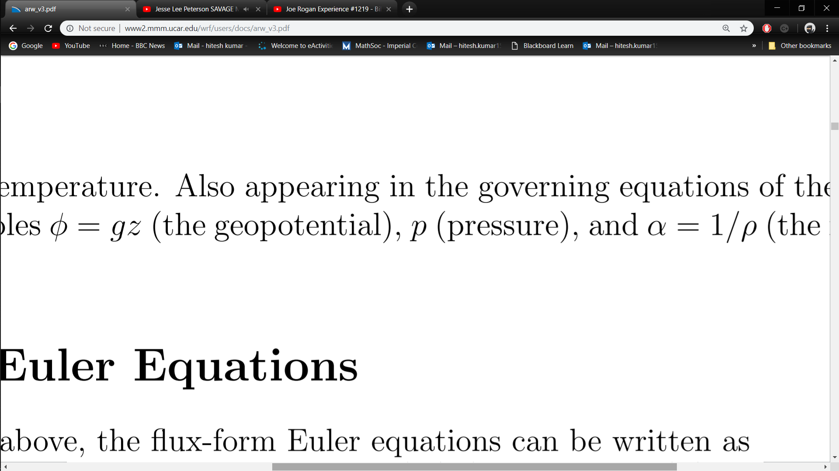
Variables of atmospheric dynamics
Geopotential
Pressure
Inverse density
Future of NWP – The fundamental process – Variables
Intro to NWP – Governing equations
Slide: 2/
Slide: 27/56

Slide 28
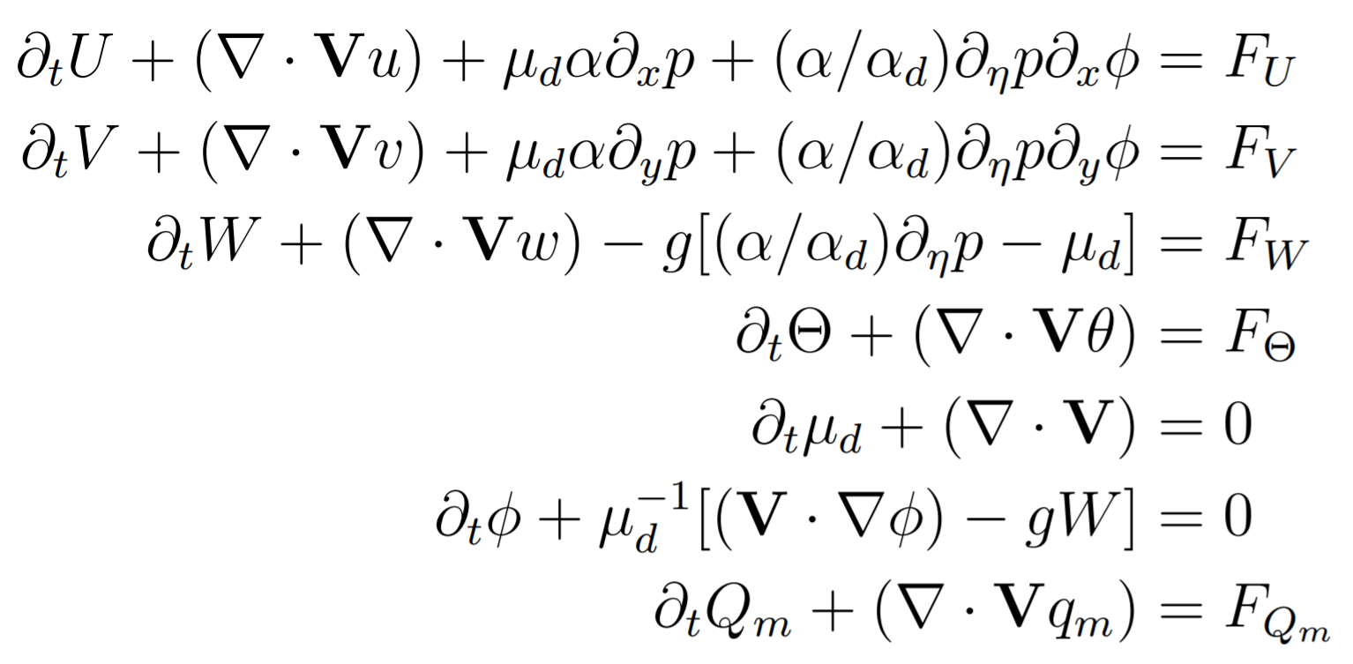
Governing equations of atmospheric dynamics
Moist Euler equations
Intro to NWP – Governing equations
Slide: 28/56
Future of NWP – The fundamental process – Governing equations
Slide: 2/

Slide 29
Contents:
The fundamental process – start to end
Domain setup + interpolation
Finding IC’s and BC’s
Governing equations
Model discretisation
Some results
Cumulative precipitation – Indian monsoon
Hurricane tracking - Florence
Problems and some solutions
Accuracy of initial conditions + Data assimilation
Post processing + Quantile mapping
Using the software (VM)
Future of NWP – Contents
Intro to NWP – Model temporo-spatial discretisation
Slide: 2/
Slide: 29/56

Slide 30
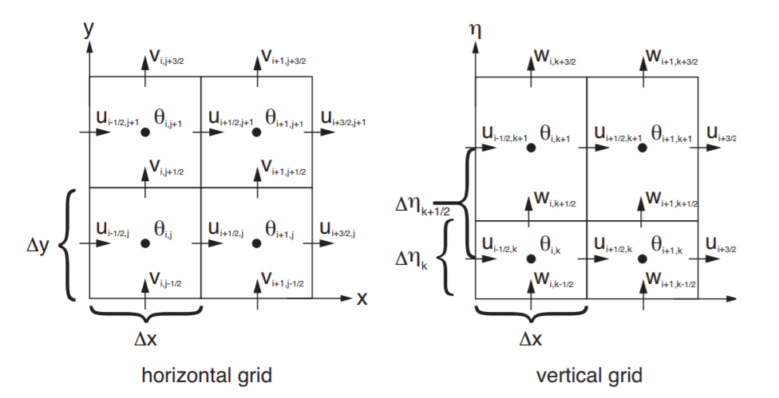
[5]
Future of NWP – The fundamental process – Finding IC’s/BC’s
Intro to NWP – Model temporo-spatial discretisation
Slide: 2/
Slide: 30/56

Slide 31
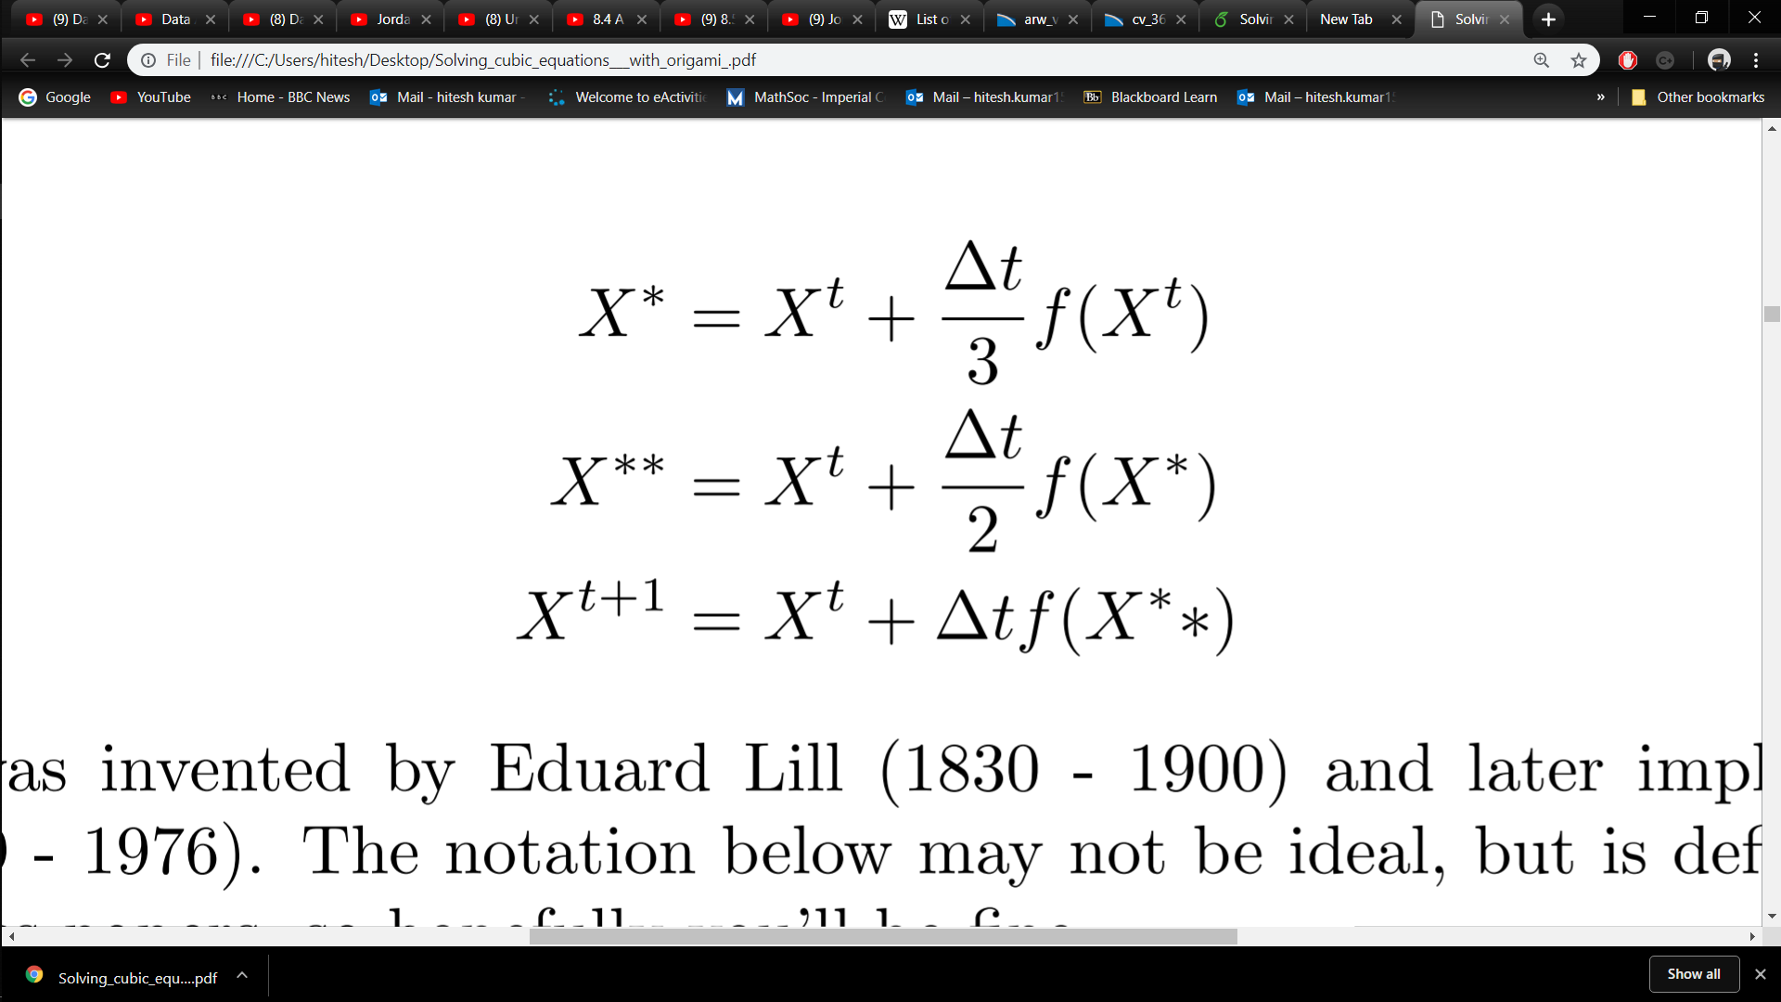
Modified RK3
Future of NWP – The fundamental process – Finding IC’s/BC’s
Intro to NWP – Model temporo-spatial discretisation
Slide: 2/
Slide: 31/56

Slide 32
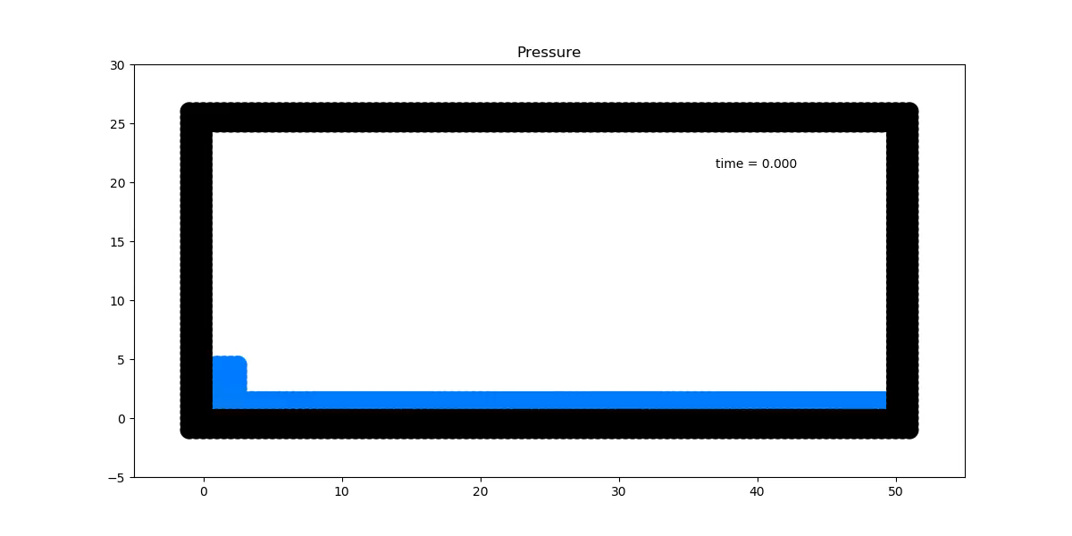
[6]

Slide 33
Contents:
The fundamental process – start to end
Domain setup + interpolation
Finding IC’s and BC’s
Governing equations
Model discretisation
Some results
Cumulative precipitation – Indian monsoon
Hurricane tracking - Florence
Problems and some solutions
Accuracy of initial conditions + Data assimilation
Post processing + Quantile mapping
Using the software (VM)
Future of NWP – Contents
Intro to NWP – Indian monsoon
Slide: 2/
Slide: 33/56

Slide 34
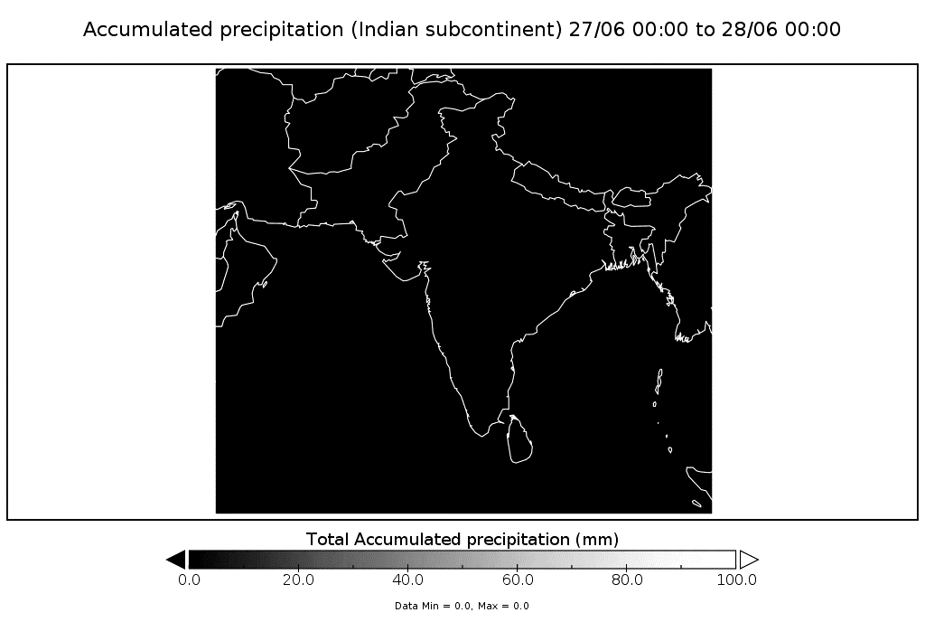

Slide 35
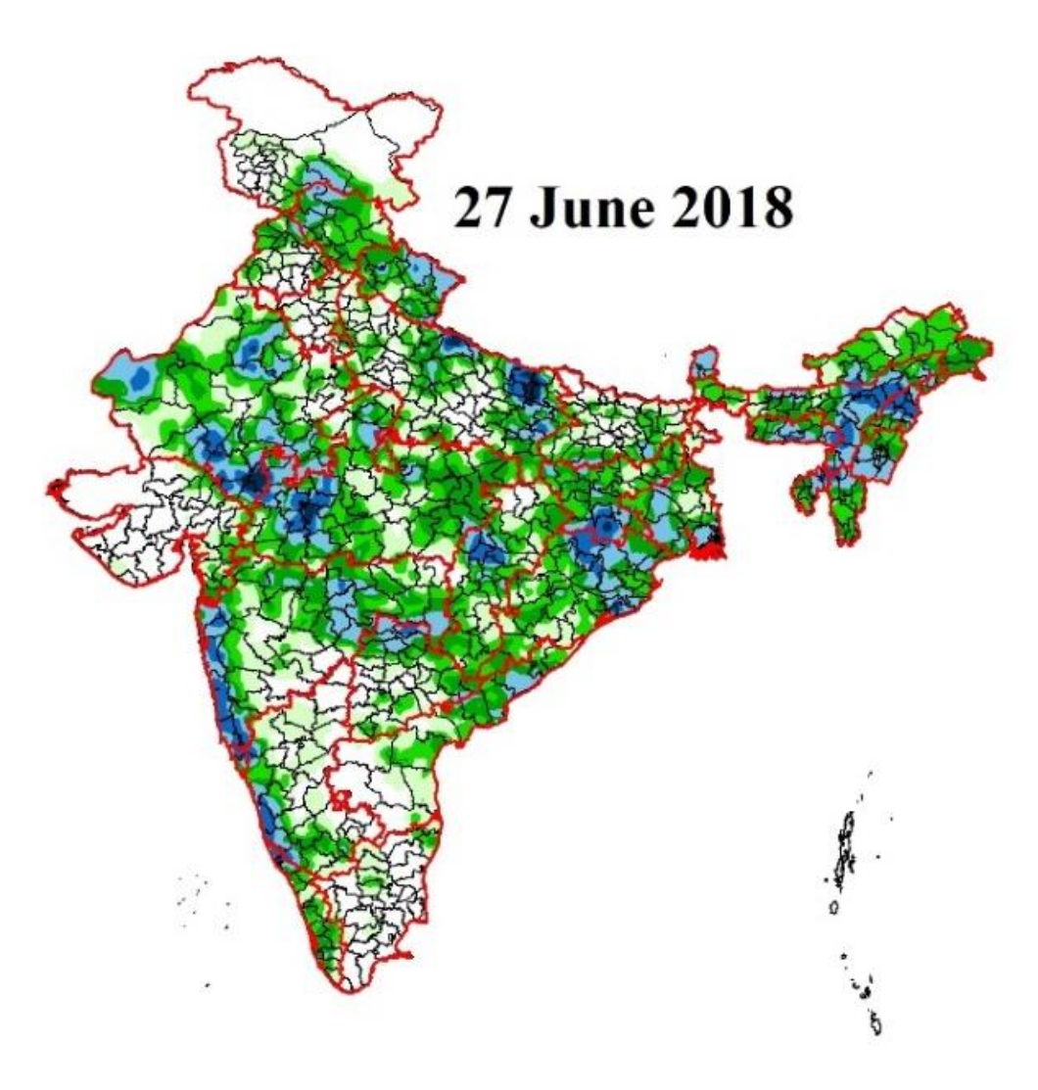
[7]

Slide 36
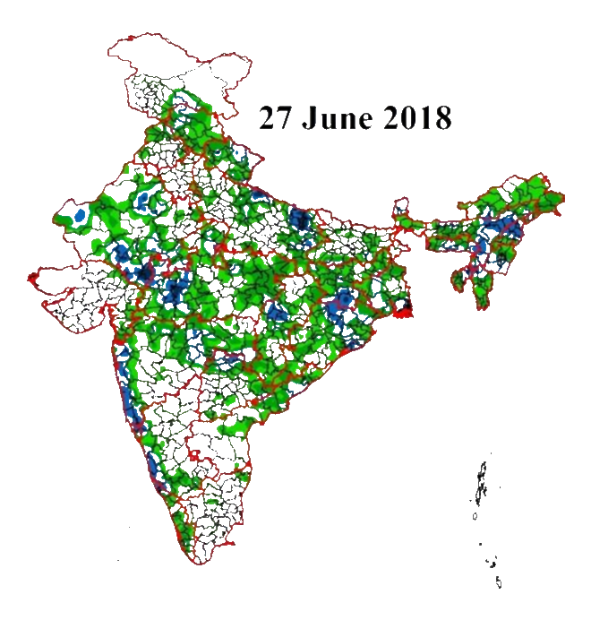

Slide 37
Contents:
The fundamental process – start to end
Domain setup + interpolation
Finding IC’s and BC’s
Governing equations
Model discretisation
Some results
Cumulative precipitation – Indian monsoon
Hurricane tracking - Florence
Problems and some solutions
Accuracy of initial conditions + Data assimilation
Post processing + Quantile mapping
Using the software (VM)
Intro to NWP – Hurricane Florence
Future of NWP – Contents
Slide: 37/56
Slide: 2/

Slide 38
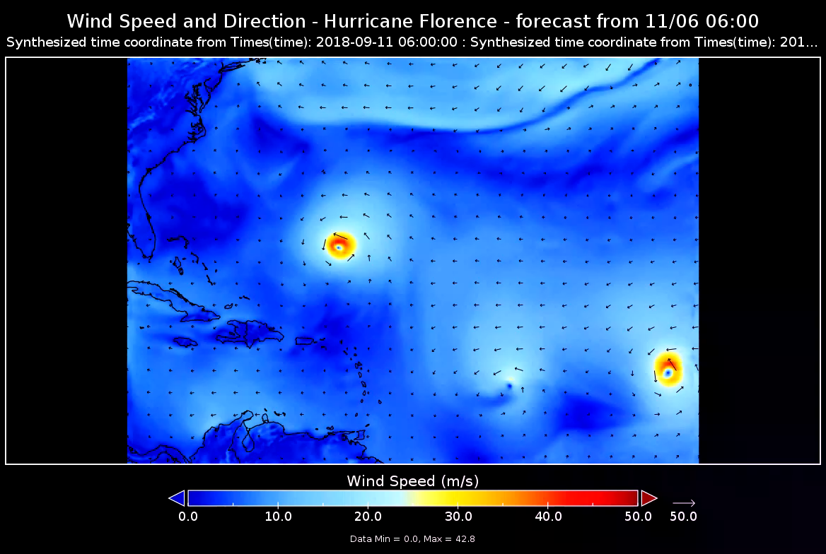

Slide 39
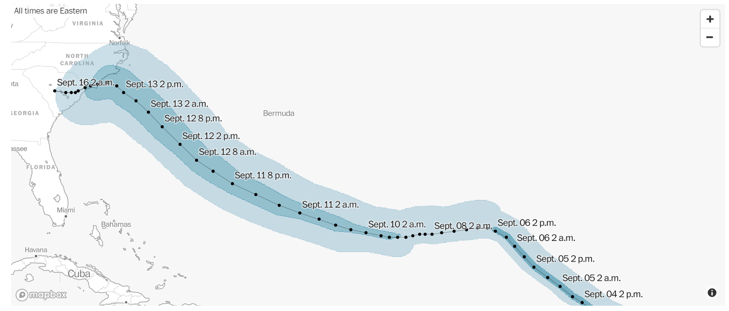
[8]

Slide 40
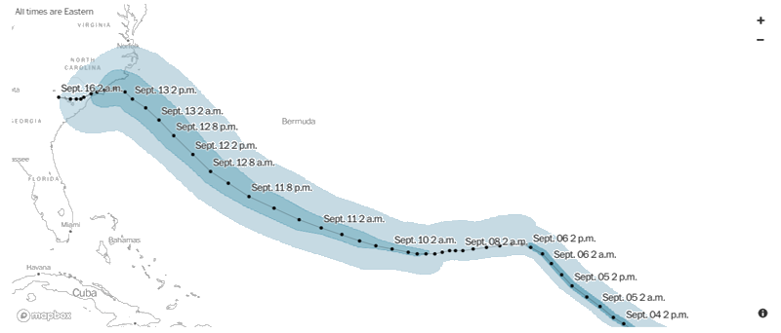

Slide 41
Contents:
The fundamental process – start to end
Domain setup + interpolation
Finding IC’s and BC’s
Governing equations
Model discretisation
Some results
Cumulative precipitation – Indian monsoon
Hurricane tracking - Florence
Problems and some solutions
Accuracy of initial conditions + Data assimilation
Post processing + Quantile mapping
Using the software (VM)
Future of NWP – Contents
Intro to NWP – Data assimilation
Slide: 2/
Slide: 41/56

Slide 42
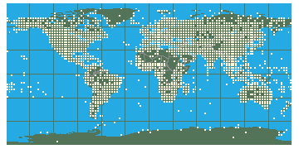
[9]
Intro to NWP – Data assimilation
Future of NWP – Contents
Slide: 42/56
Slide: 2/

Slide 43
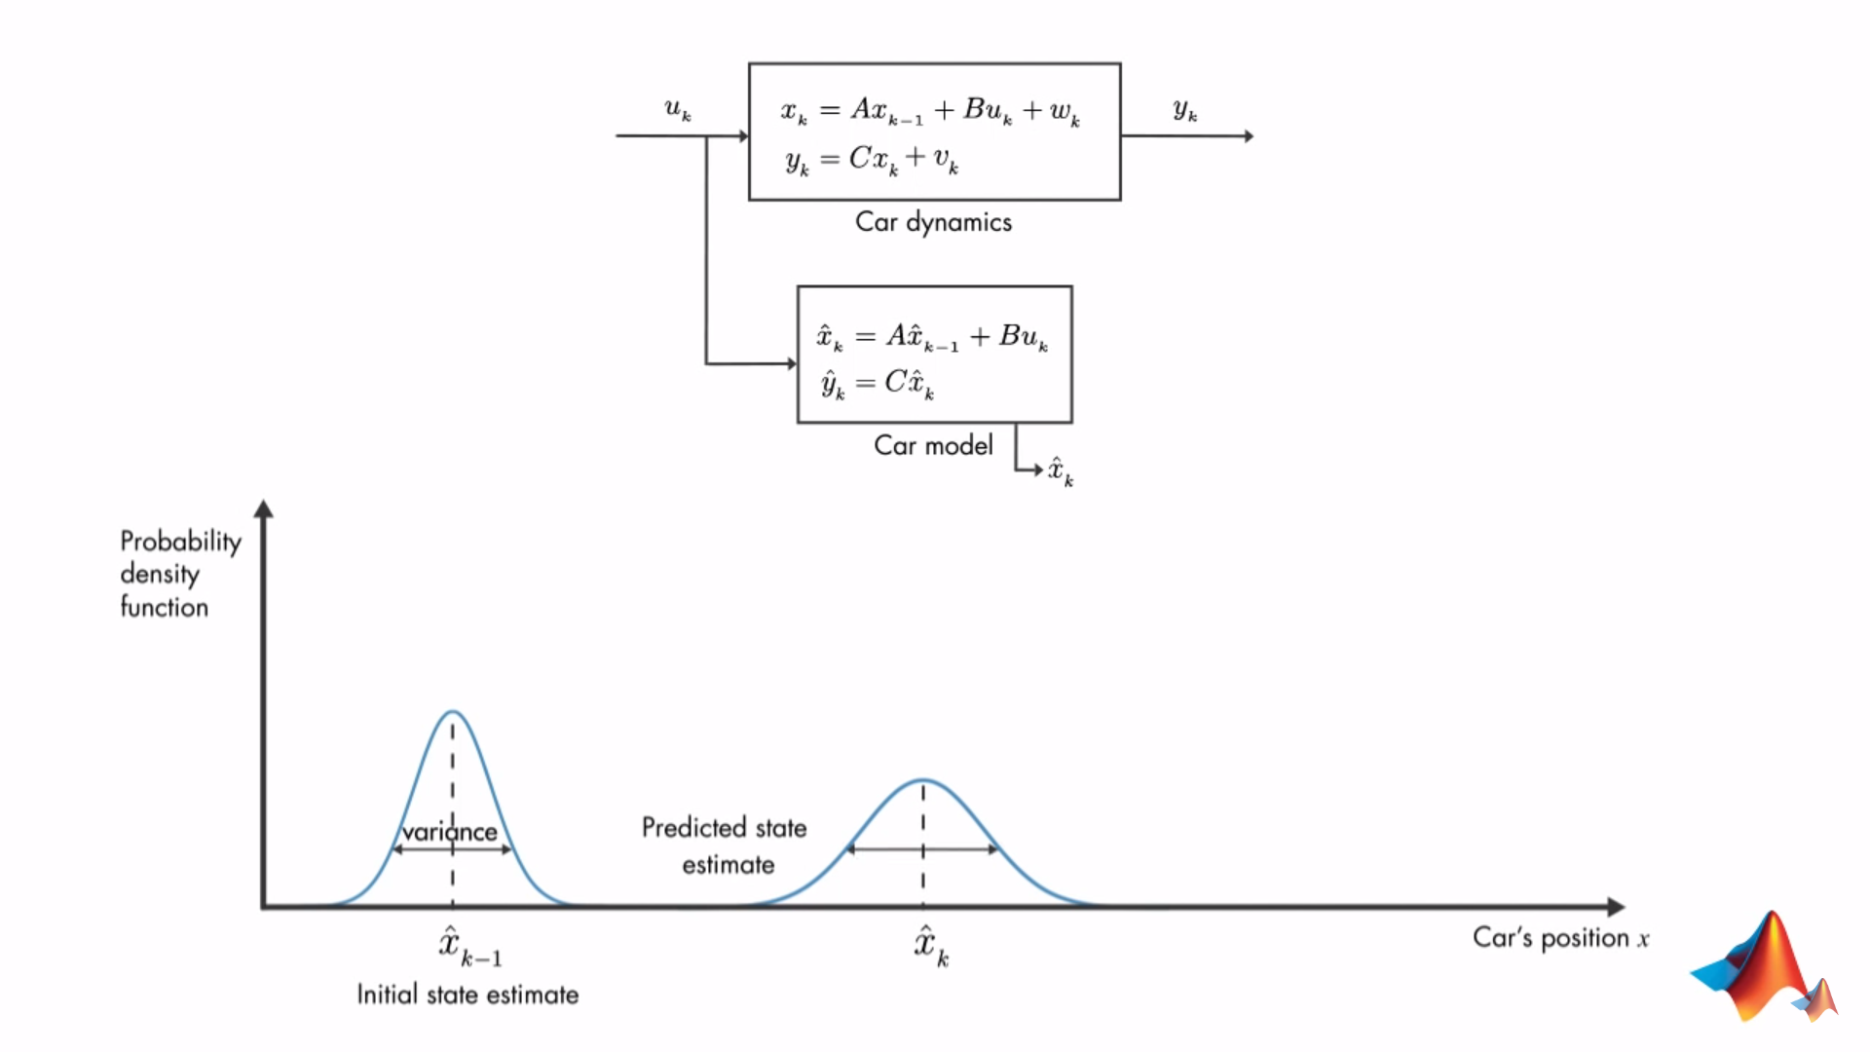

[10]
Intro to NWP – Data assimilation
Future of NWP – Contents
Slide: 43/56
Slide: 2/

Slide 44
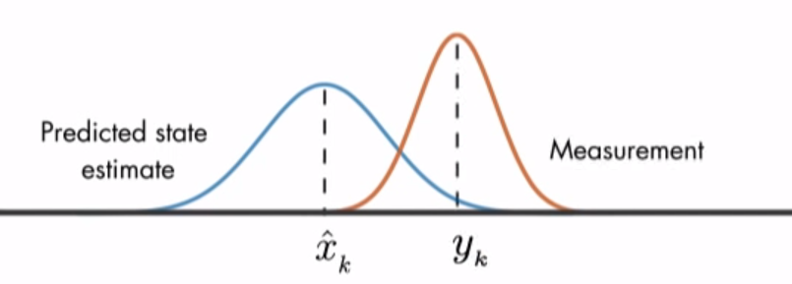
[10]
Intro to NWP – Data assimilation
Future of NWP – Contents
Slide: 44/56
Slide: 2/

Slide 45
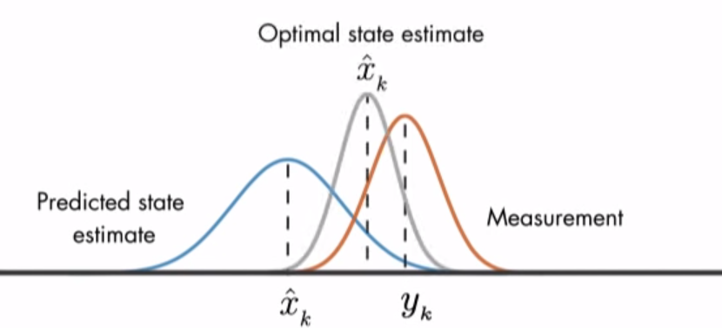
[10]
Intro to NWP – Data assimilation
Future of NWP – Contents
Slide: 45/56
Slide: 2/

Slide 46
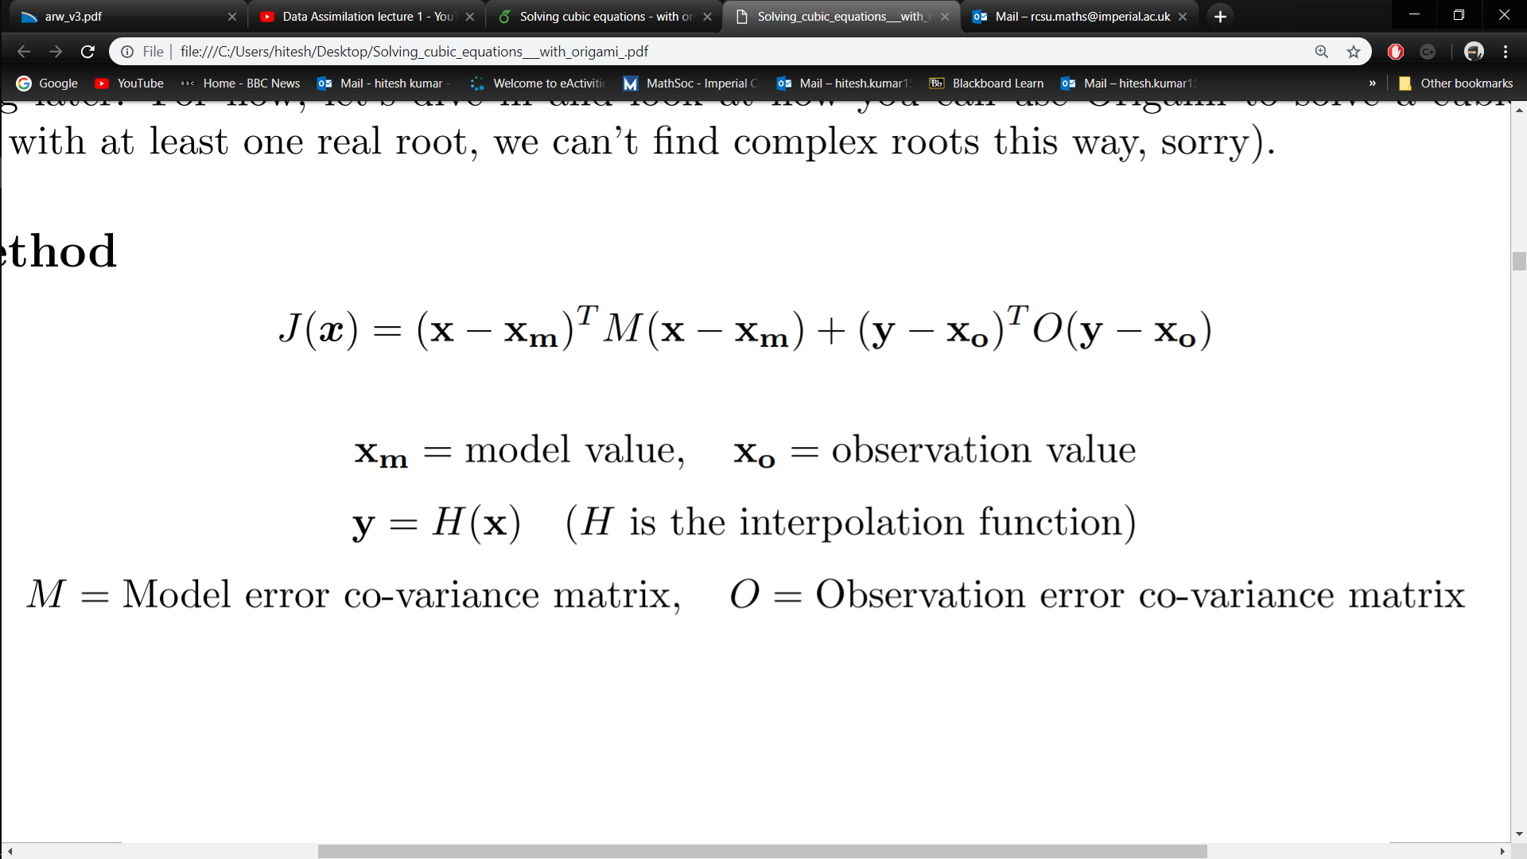
Intro to NWP – Data assimilation
Future of NWP – Contents
Slide: 46/56
Slide: 2/

Slide 47
Contents:
The fundamental process – start to end
Domain setup + interpolation
Finding IC’s and BC’s
Governing equations
Model discretisation
Some results
Cumulative precipitation – Indian monsoon
Hurricane tracking - Florence
Problems and some solutions
Accuracy of initial conditions - Data assimilation
Post processing - Quantile mapping
Using the software (VM)
Future of NWP – Contents
Intro to NWP – Quantile mapping
Slide: 2/
Slide: 47/56

Slide 48
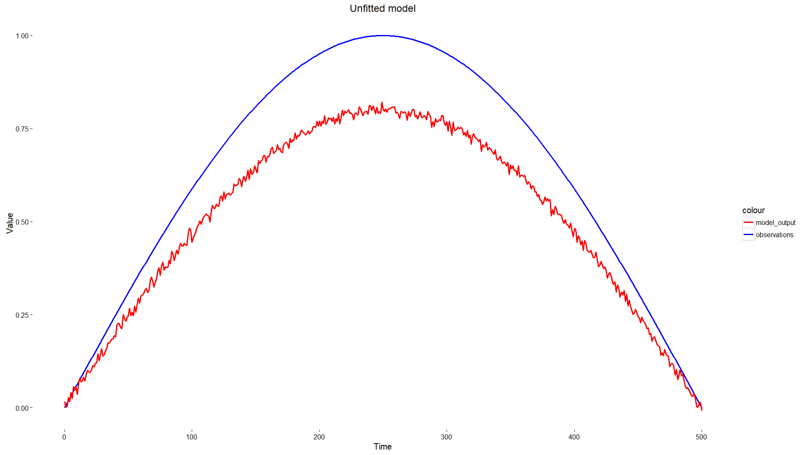
Post-processing of time series data
Future of NWP – The fundamental process – Finding IC’s/BC’s
Intro to NWP – Quantile mapping
Slide: 2/
Slide: 48/56

Slide 49
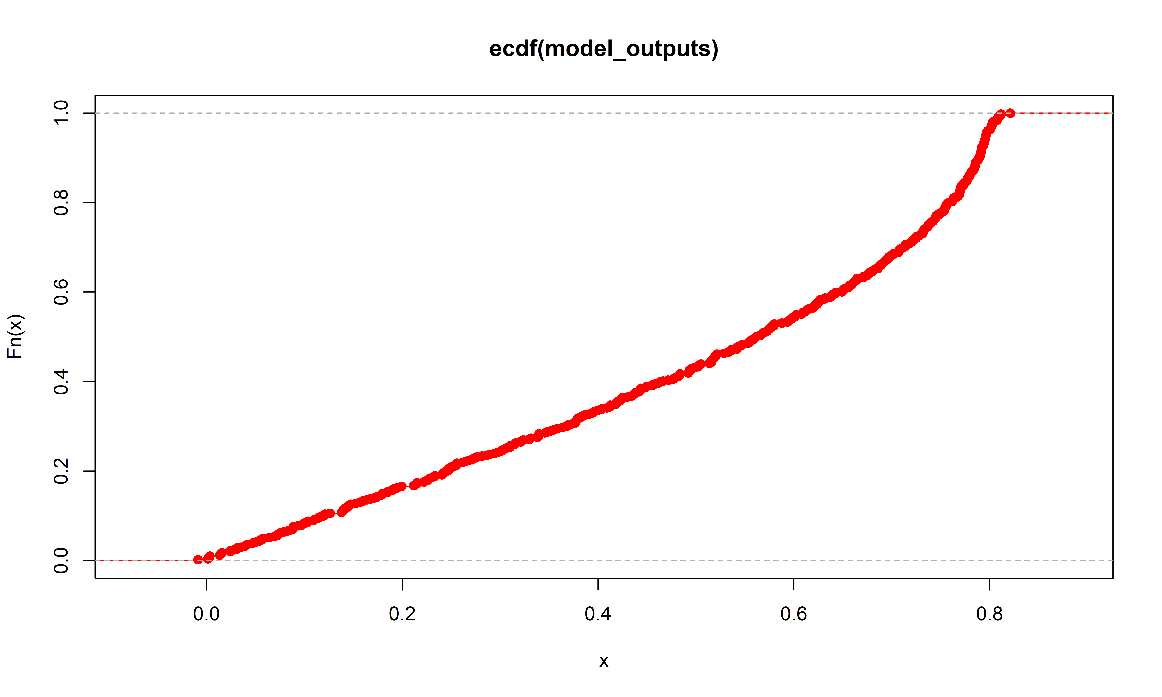
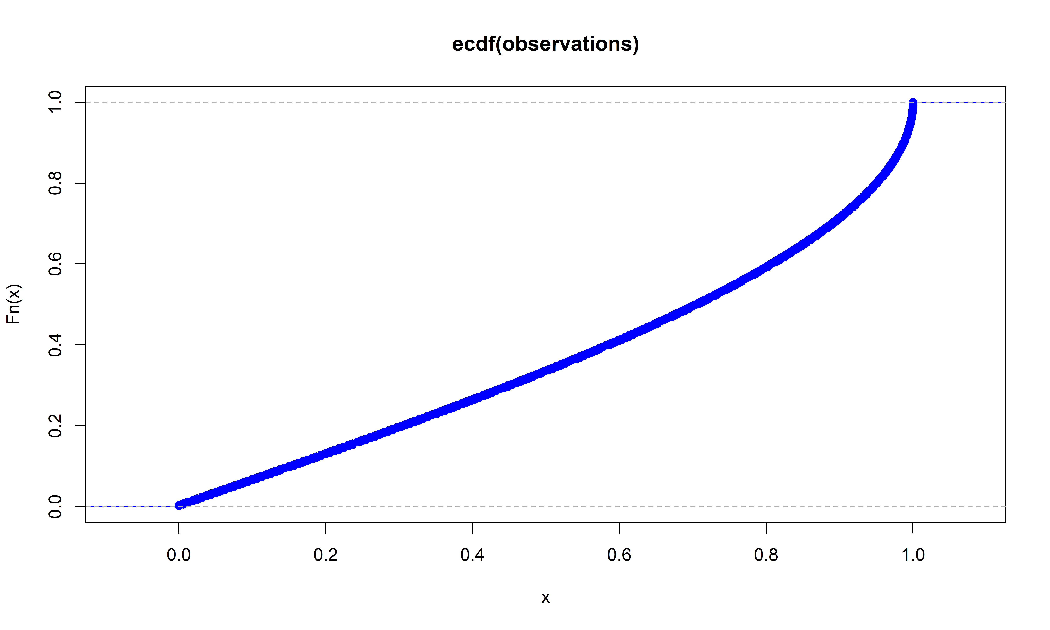
Future of NWP – The fundamental process – Finding IC’s/BC’s
Intro to NWP – Quantile mapping
Slide: 2/
Slide: 49/56

Slide 50
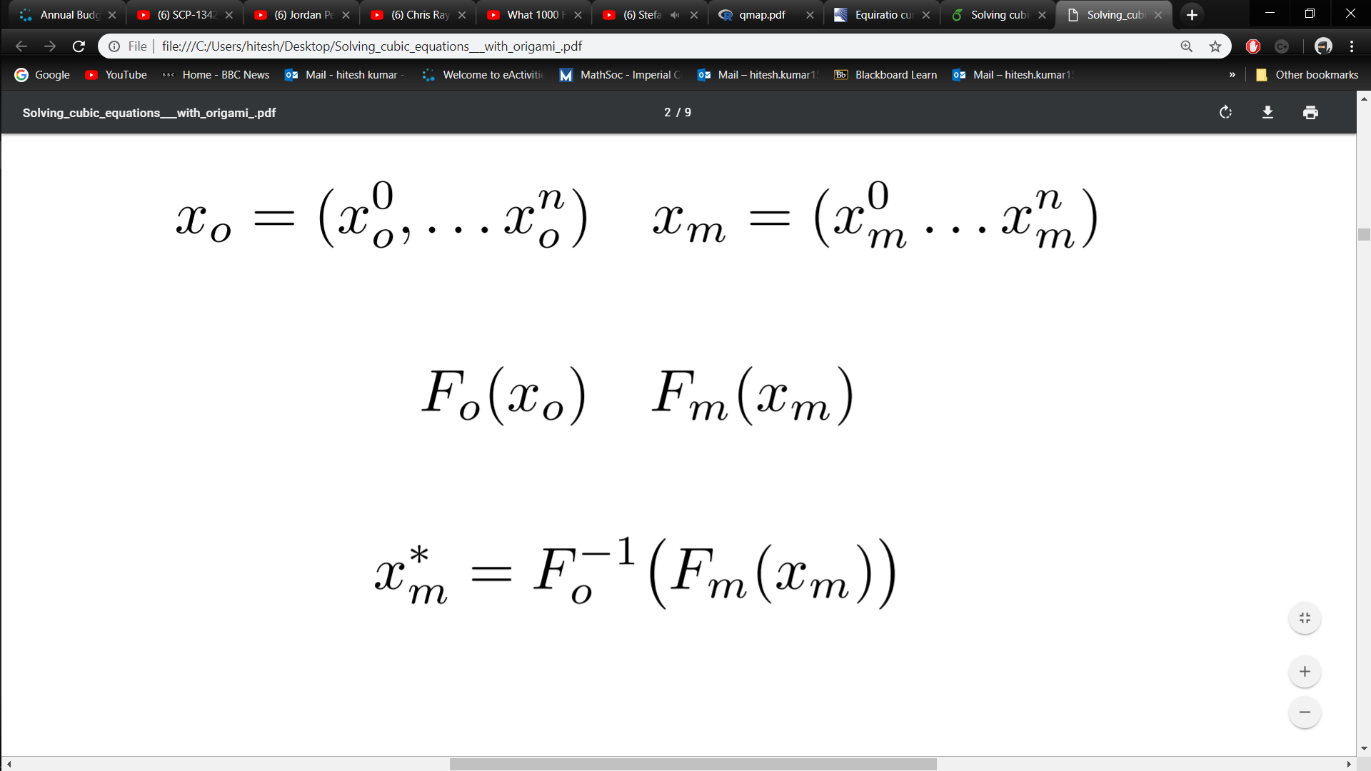
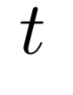
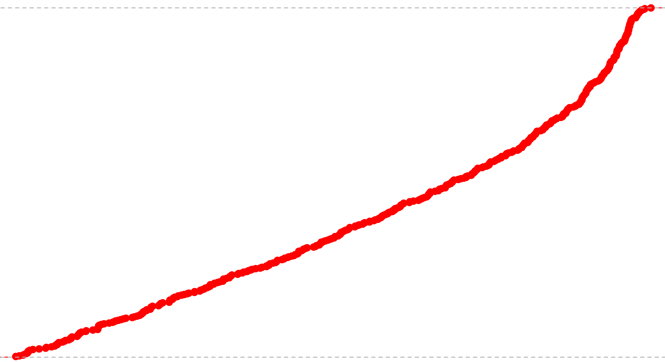
Future of NWP – The fundamental process – Finding IC’s/BC’s
Intro to NWP – Quantile mapping
Slide: 2/
Slide: 50/56

Slide 51
Future of NWP – The fundamental process – Finding IC’s/BC’s
Intro to NWP – Quantile mapping
Slide: 2/
Slide: 51/56

Slide 52
Future of NWP – The fundamental process – Finding IC’s/BC’s
Intro to NWP – Quantile mapping
Slide: 2/
Slide: 52/56

Slide 53
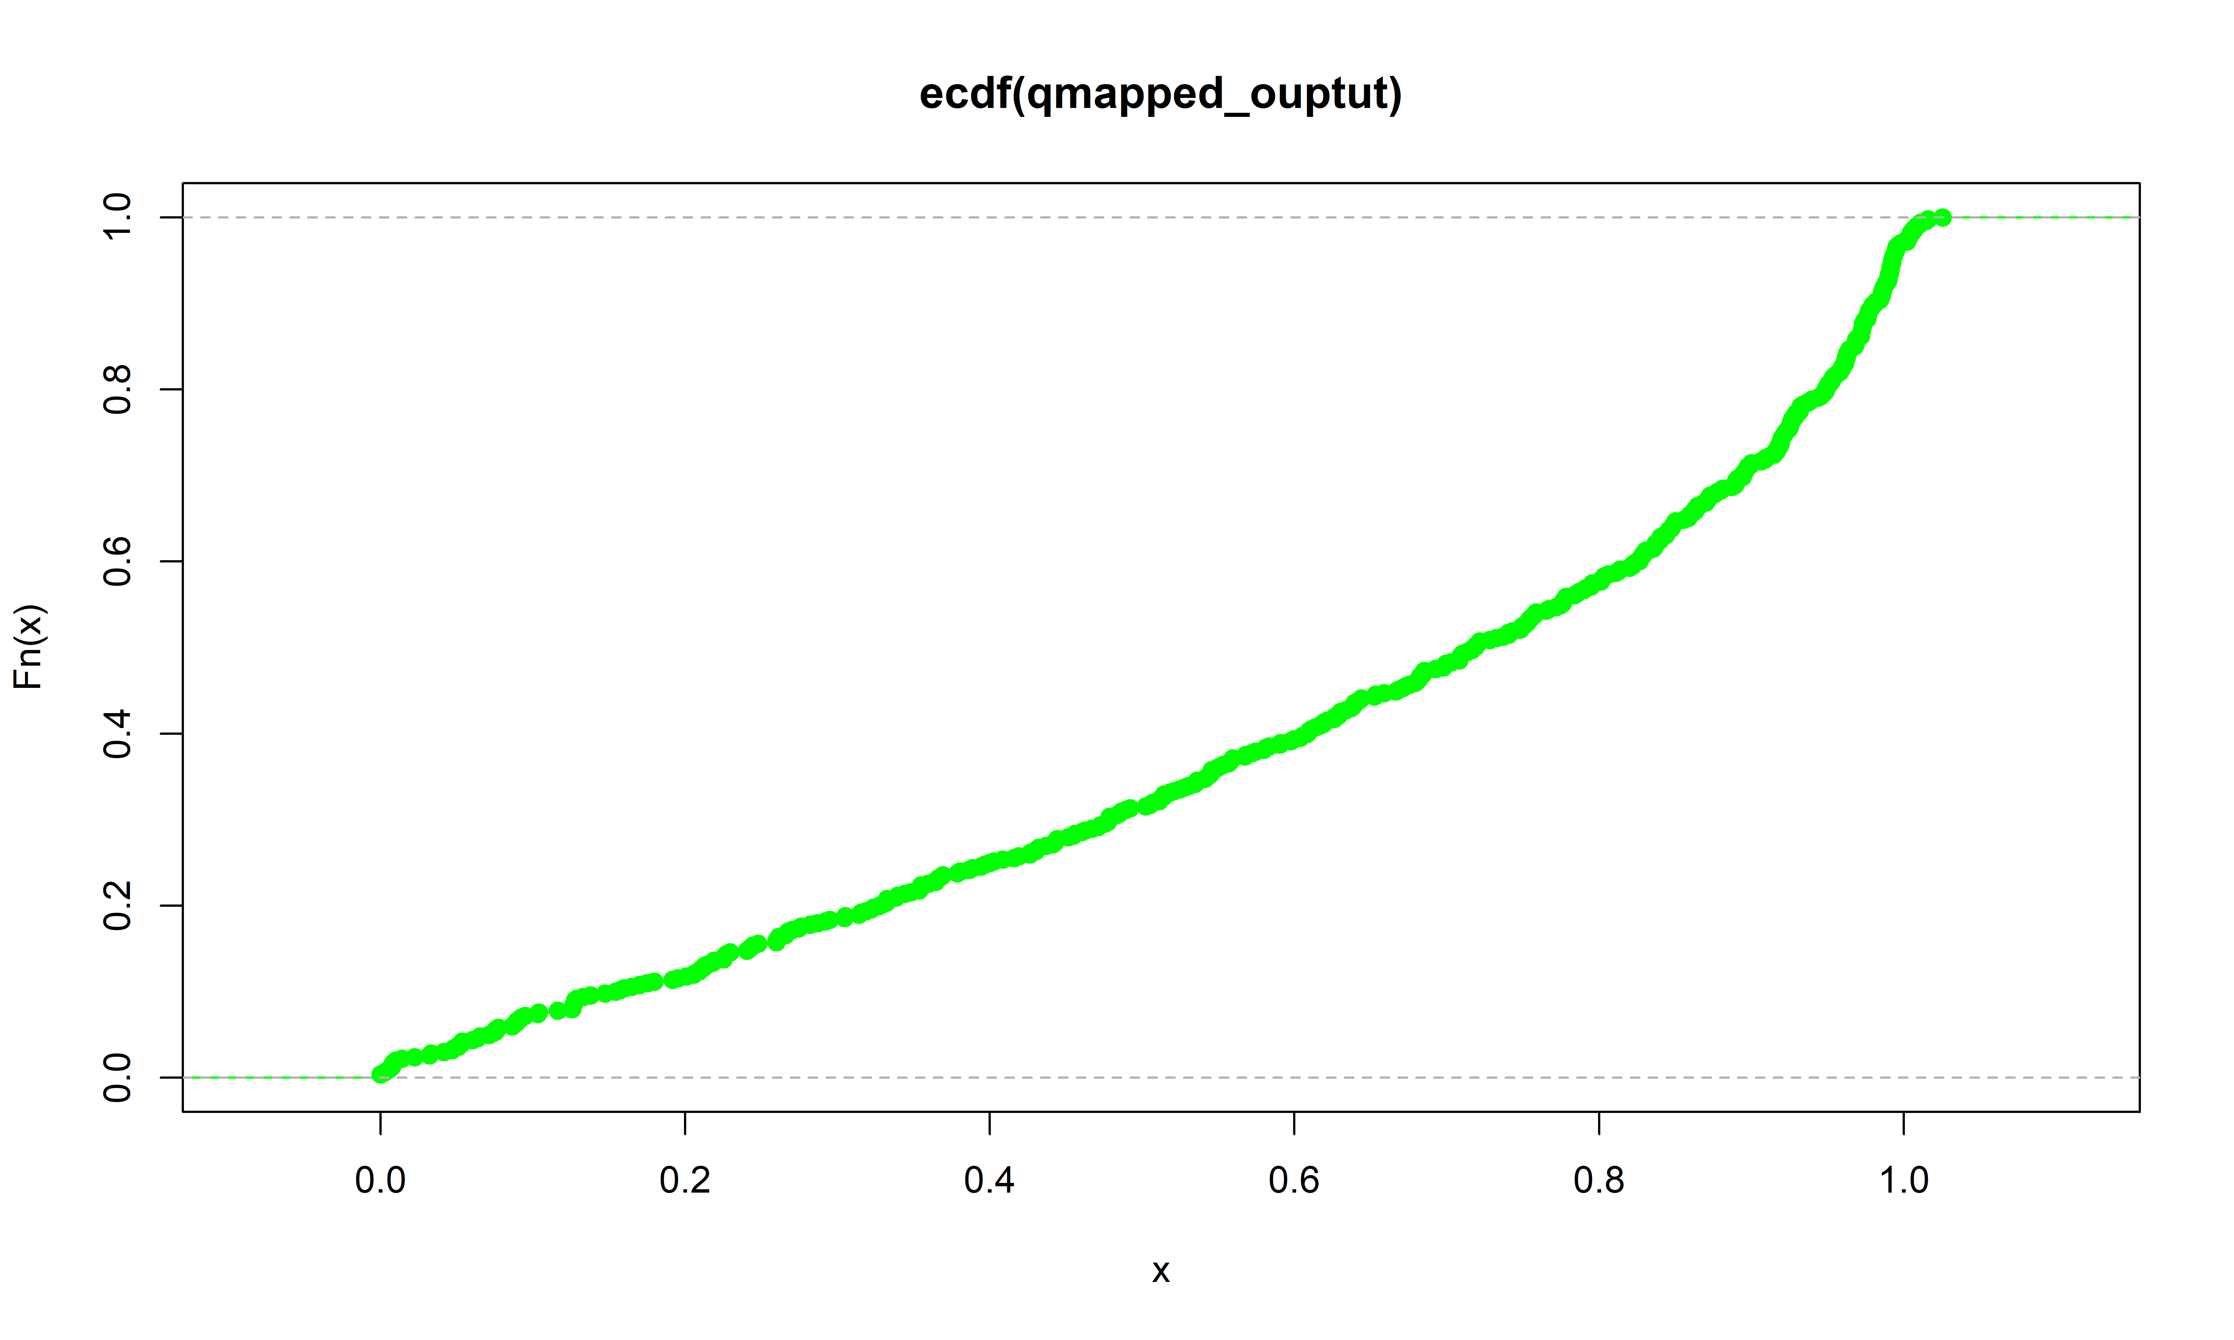
Future of NWP – The fundamental process – Finding IC’s/BC’s
Intro to NWP – Quantile mapping
Slide: 2/
Slide: 53/56

Slide 54
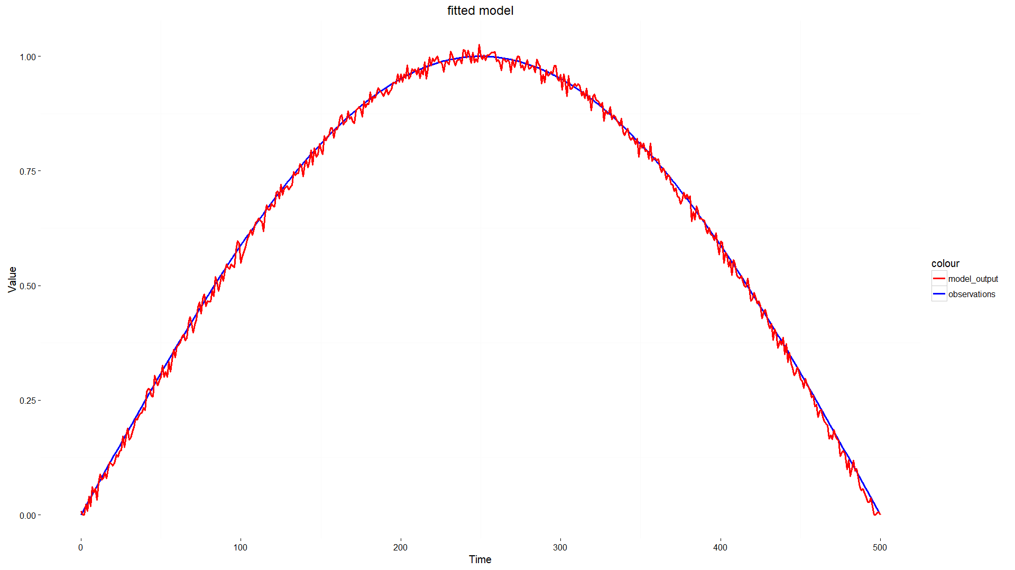
Future of NWP – The fundamental process – Finding IC’s/BC’s
Intro to NWP – Quantile mapping
Slide: 2/
Slide: 54/56

Slide 55
Contents:
The fundamental process – start to end
Domain setup + interpolation
Finding IC’s and BC’s
Governing equations
Model discretisation
Some results
Cumulative precipitation – Indian monsoon
Hurricane tracking - Florence
Problems and some solutions
Accuracy of initial conditions + Data assimilation
Post processing + Quantile mapping
Using the software (VM)
Intro to NWP – Using the software (Virtual Machine)
Future of NWP – Contents
Slide: 55/56
Slide: 2/

Slide 56
References:
[1]: William C. Skamarock, Joseph B. Klemp, Jimy Dudhia, David O. Gill, Dale M. Barker, Michael G. Duda, Xiang-Yu Huang Wei Wang, Jordan G. Powers - 2008 - A description of the advanced research WRF V3 - p.7
[2]: Wei Wang, Cindy Bruyère, Michael Duda, Jimy Dudhia, Dave Gill, Michael Kavulich, Kelly Keene, Ming Chen, Hui-Chuan Lin, John Michalakes, Syed Rizvi, Xin Zhang, Judith Berner, Soyoung Ha, Kate Fossell- WRF users guide V3.9- p.(3-11)
[3]: Robert Israel – 2003 - Mercator's Projection
[4]: William C. Skamarock, Joseph B. Klemp, Jimy Dudhia, David O. Gill, Dale M. Barker, Michael G. Duda, Xiang-Yu Huang Wei Wang, Jordan G. Powers - 2008 - A description of the advanced research WRF V3 - p.53
[5]: William C. Skamarock, Joseph B. Klemp, Jimy Dudhia, David O. Gill, Dale M. Barker, Michael G. Duda, Xiang-Yu Huang Wei Wang, Jordan G. Powers - 2008 - A description of the advanced research WRF V3 - p.19
[6]: Hugo Coussens (Team Pacific, ACSE 2018/19, Imperial College London) – 20/01/2019
[7]: India meteorological department – 20/01/2019 – Insat3D
[8]: The Washington Post – 13/09/2018 - Tracking Hurricane Florence
[9]: NCAR RDA – 22/01/2019 - NCEP ADP Global Upper Air Observational Weather Data, October 1999 - continuing
[10]: Understanding Kalman Filters, Part 1: Why Use Kalman Filters? – 22/01/2019 – YouTube - MATLAB
Intro to NWP – References
Future of NWP – Contents
Slide: 56/56
Slide: 2/

